Slide 1
RNA-seq with R-bioconductor Part 2: Dealing with Unwanted Variation
Maarten Leerkes PhD

Slide 2
Refresher: Three Aspects
What is R
What is Bioconductor
What is RNAseq

Slide 3
Sequencing by Synthesis
Intro to Sequencing by Synthesis: Industry-leading Data Quality
https://www.youtube.com/watch?v=HMyCqWhwB8E

Slide 4
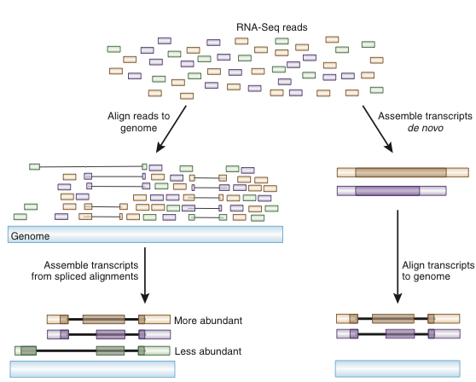
Numerous Possible Analysis Strategies
There is no one ‘correct’ way to analyze RNA-seq data
Two major branches
Direct alignment of reads (spliced or unspliced) to genome or transcriptome
Assembly of reads followed by alignment*
*Assembly is the only option when working with a creature with no genome sequence, alignment of contigs may be to ESTs, cDNAs etc
or transcriptome
Image from Haas & Zody, 2010

Slide 5
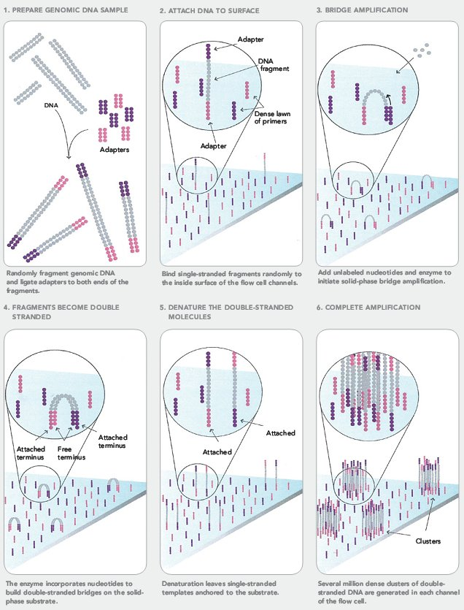
The Basis Of Illumina Sequencing On A Flow Cell
Notes:
As before a fragment library is produced in which adaptors are ligated to opposite ends of the fragments. Linkers that are covalently attached to the surface of the flow cell capture the library and a bridge is formed between these. Isothermal amplification is then initiated from the double stranded ends of the bridge. Displacement and re-annealing to the surface and amplification of the locally bound sequence thus forms a cluster of clonally expanded sequences. Finally opening of the bridge allows the release of one end in preparation for sequencing (figure 4).

Slide 6
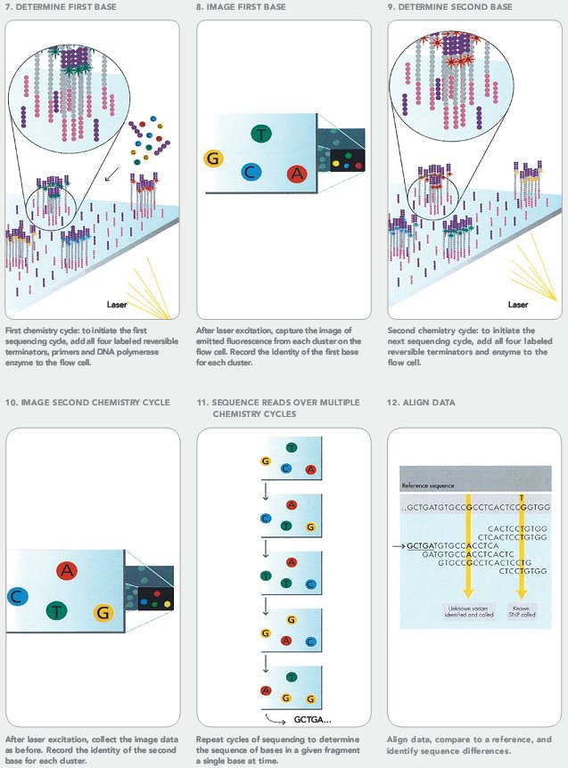
Illumina Clonal Expansion Followed By Image Processing
Notes:
Both the Illumina and SOLiDTM chemistry differ from 454TM in that they incorporate florescent dyes as markers of nucleotide extension. Illumina employ a novel approach to clonal expansion termed bridge amplification. This is performed on the surface of the flow cell (see figure 3).

Slide 7
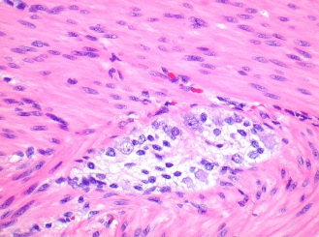
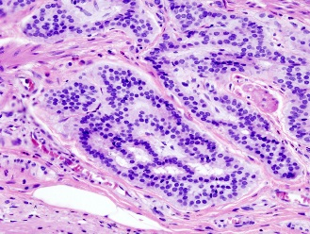
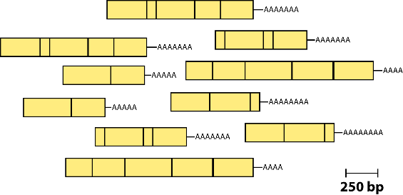
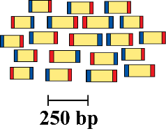
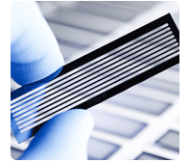
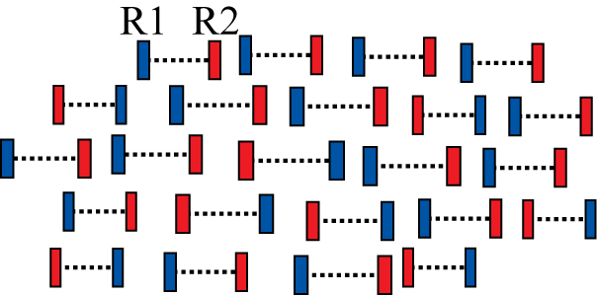
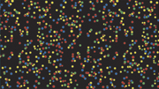
RNA Sequencing: Abundance Comparisons Between Two Or More Conditions / Phenotypes
Samples of interest
Isolate RNAs
Generate cDNA, fragment, size select, add linkers
Condition 1
(normal tissue)
Condition 2
(diseased tissue)
Sequence ends
Map to genome, transcriptome, and predicted exon junctions
100s of millions of paired reads
10s of billions bases of sequence
Downstream analysis

Slide 8
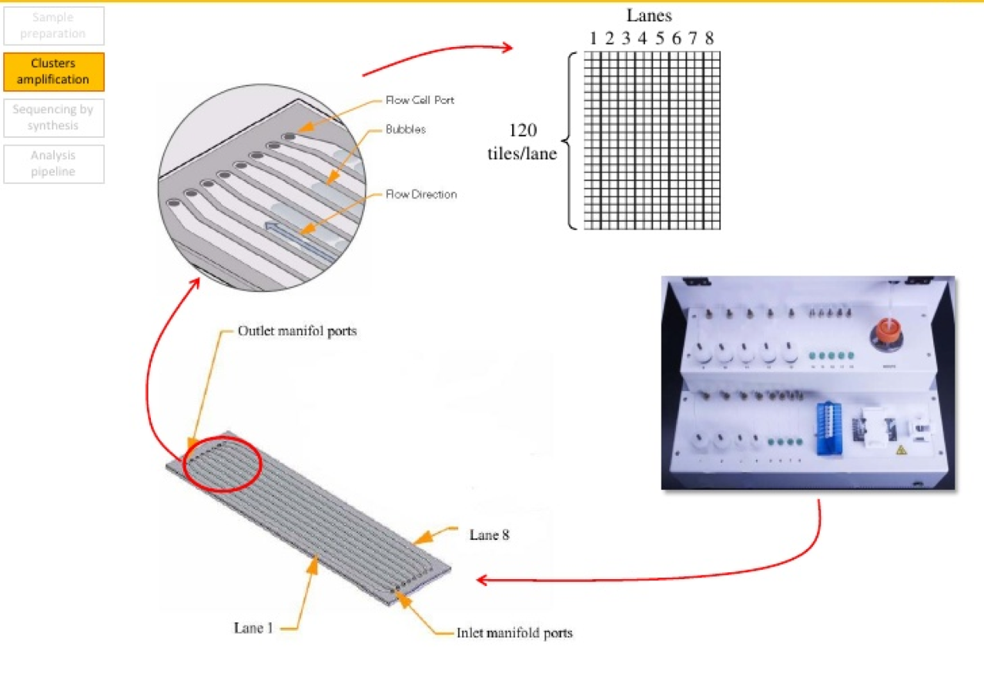

Slide 9
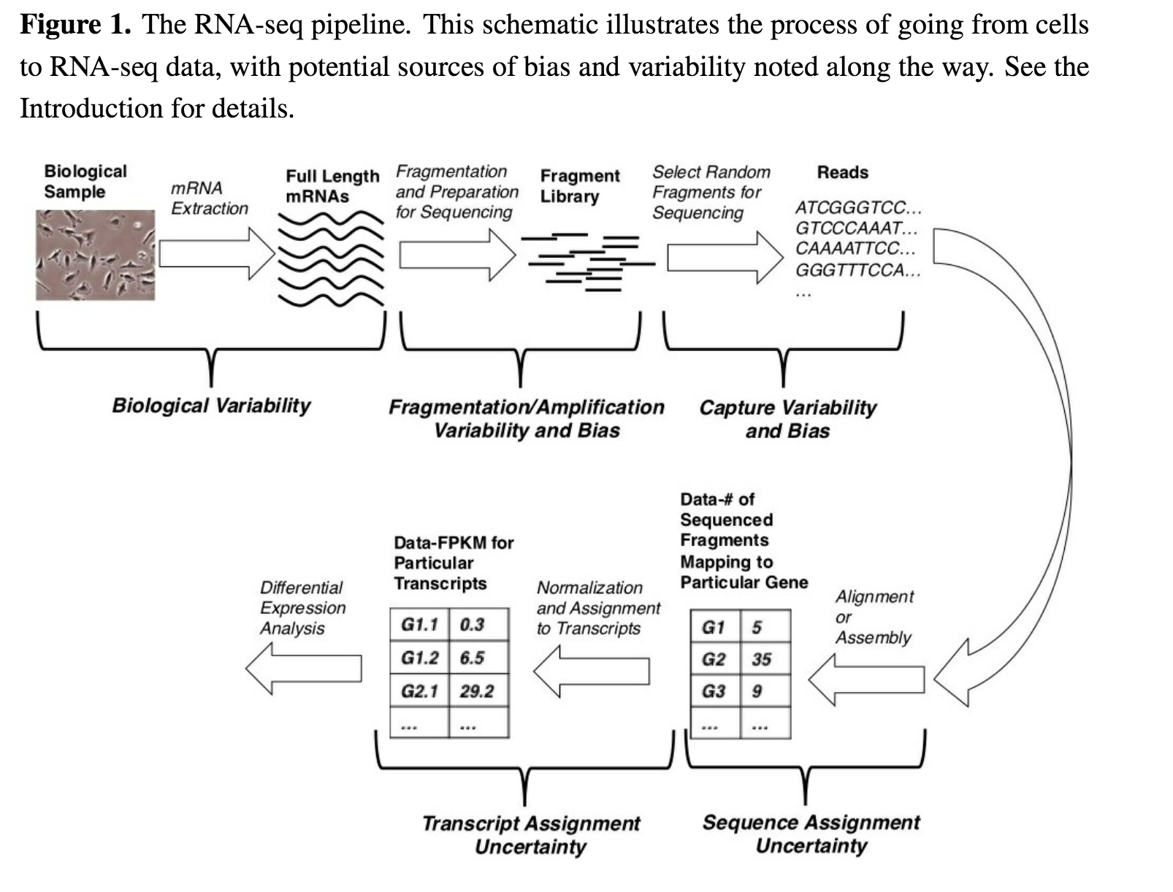
Potential Sources Of Bias And Variability
Notes:
http://arxiv.org/ftp/arxiv/papers/1505/1505.02017.pdf

Slide 10
What is Normalization
The output of the Tophat-Cufflinks pipeline for every condition are estimates of the mean and variance of At for each transcript t (Â_{t} and VˆA_{t}), which specify an associated normal distribution. http://www.ncbi.nlm.nih.gov/pmc/articles/PMC4263583/pdf/biosensors-03-00238.pdf
Notes:
http://arxiv.org/ftp/arxiv/papers/1505/1505.02017.pdf

Slide 11
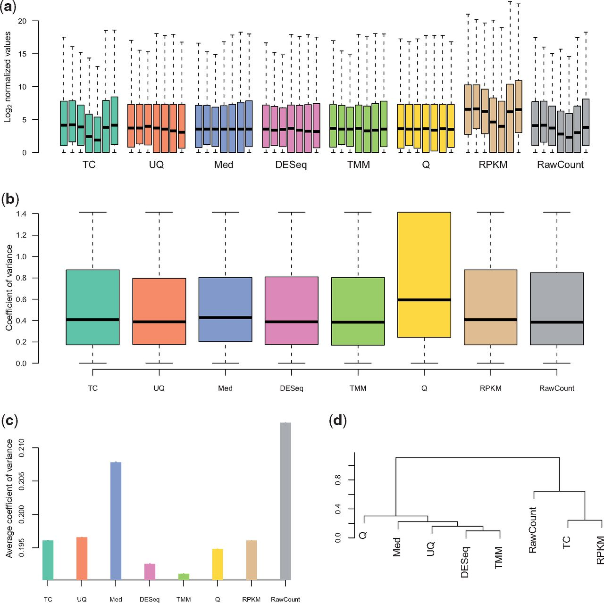

Comparison of normalization methods
for real data.
Marie-Agnès Dillies et al. Brief Bioinform 2013;14:671-683
© The Author 2012. Published by Oxford University Press.
Notes:
Comparison of normalization methods for real data. (A) Boxplots of log2(counts + 1) for all conditions and replicates in the M. musculus data, by normalization method. (B) Boxplots of intra-group variance for one of the conditions (labeled ‘B’ in the corresponding data found in Supplementary Data) in the M. musculus data, by normalization method. (C) Analysis of housekeeping genes for the H. sapiens data. (D) Consensus dendrogram of differential analysis results, using the DESeq Bioconductor package, for all normalization methods across the four datasets under consideration.

Slide 12
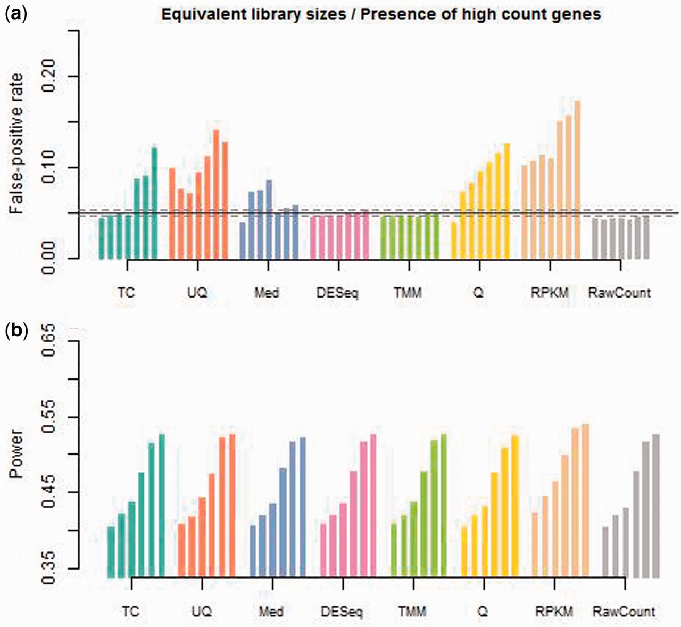
Comparison of normalization methods for simulated data with equal library sizes and the presence of high-count genes.
Marie-Agnès Dillies et al. Brief Bioinform 2013;14:671-683
© The Author 2012. Published by Oxford University Press.
Notes:
Comparison of normalization methods for simulated data with equal library sizes and the presence of high-count genes. (A) Average false-positive rate over 10 independent datasets simulated with varying proportions of differentially expressed genes (from 0% to 30% for each normalization method). (B) Power over 10 independent datasets simulated with varying proportions of differentially expressed genes (from 5% to 30% for each normalization method).

Slide 13
Normalization
One often overlooked aspect is normalization, which is the transformation of values that allows comparisons between samples in a way that eliminates the effects of sources of variability that are not of interest.
We refer to those effects as ‘unwanted variation’. A variety of technical and biological factors, collectively known as ‘batch effects’, contribute unwanted variation to genome-wide gene expression data. These factors include differences in amount of RNA, library preparation, equipment, operators, and procedures for sample extraction, preservation, or storage. Proper normalization, or removal of these factors, has been shown to critically impact the analysis of high-throughput data (1–3). In spite of this, commonly used methods for RNA-seq normalization, such as upper quartile scaling (UQ)(2), trimmed mean of M values (TMM)(4) and FPKM (5), account only for global differences in sequencing depth between libraries (6).

Slide 14
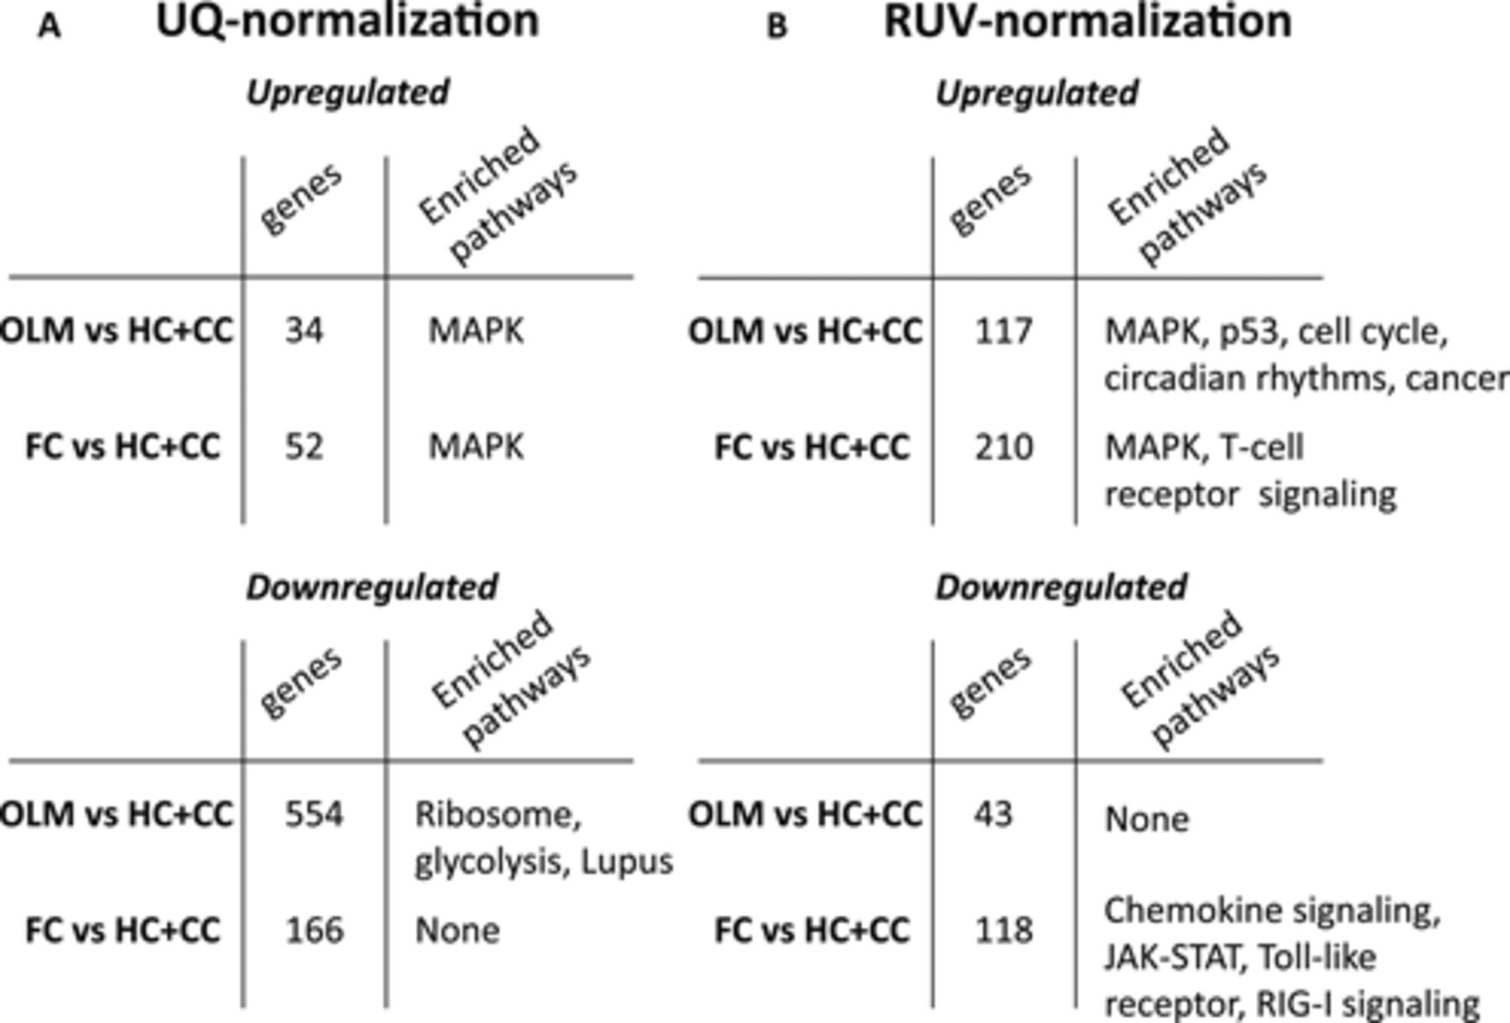

Quantitative and qualitative effects of the choice of normalization method in combined analysis of gene expression changes following FC and OLM. (A) Number of genes and enriched KEGG pathways for OLM and FC relative to combined controls following UQ normalization.
Lucia Peixoto et al. Nucl. Acids Res. 2015;nar.gkv736
© The Author(s) 2015. Published by Oxford University Press on behalf of Nucleic Acids Research.
Notes:
Quantitative and qualitative effects of the choice of normalization method in combined analysis of gene expression changes following FC and OLM. (A) Number of genes and enriched KEGG pathways for OLM and FC relative to combined controls following UQ normalization. UQ normalization leads to inferring housekeeping genes as differentially expressed. (B) Number of genes and enriched KEGG pathways for OLM and FC relative to combined controls following RUVs normalization. The apparent regulation of housekeeping genes has been removed.

Slide 15
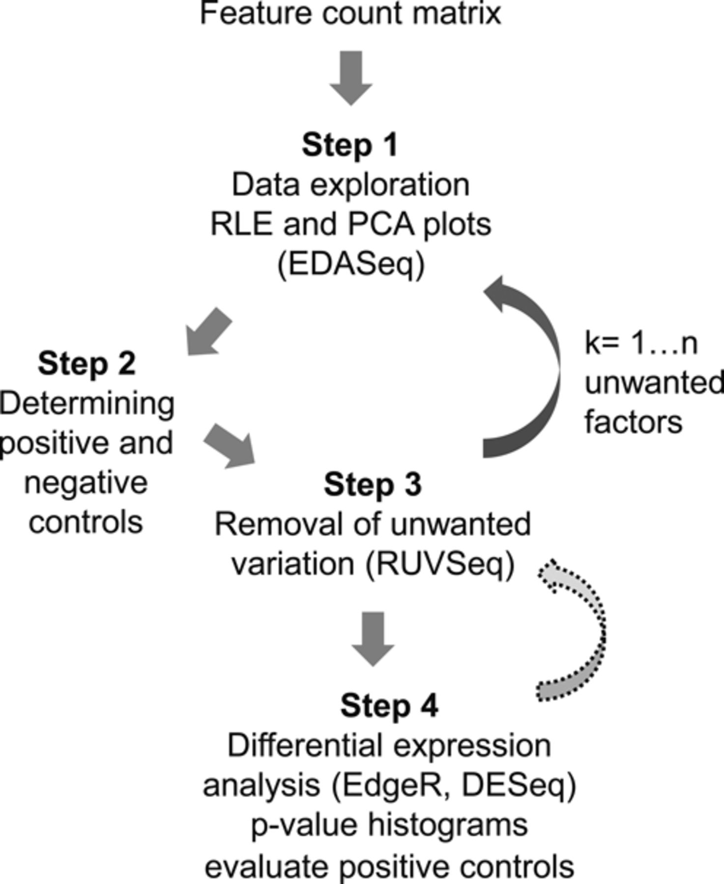
Step-by-step outline of the application of RUV to normalization of RNA-seq data.
Lucia Peixoto et al. Nucl. Acids Res. 2015;nar.gkv736
© The Author(s) 2015. Published by Oxford University Press on behalf of Nucleic Acids Research.
Notes:
Step-by-step outline of the application of RUV to normalization of RNA-seq data.

Slide 16
Using Controls For The Normalization Of Rna-seq Data

Slide 17
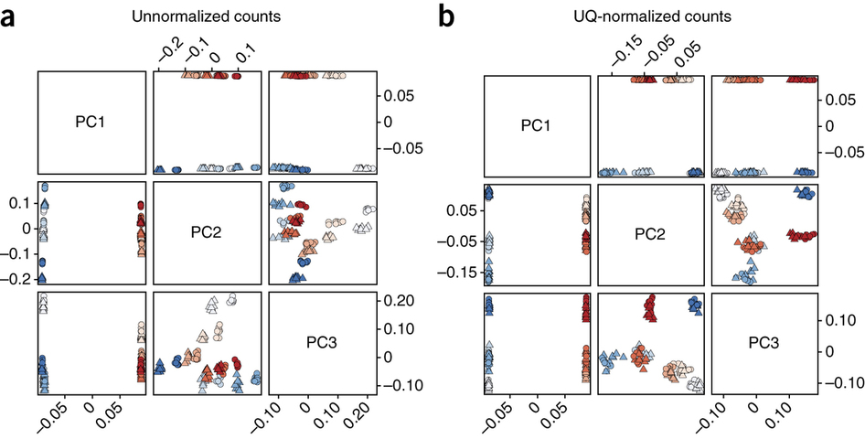
Notes:
Figure 1: Unwanted variation in the SEQC RNA-seq data set.

Slide 18
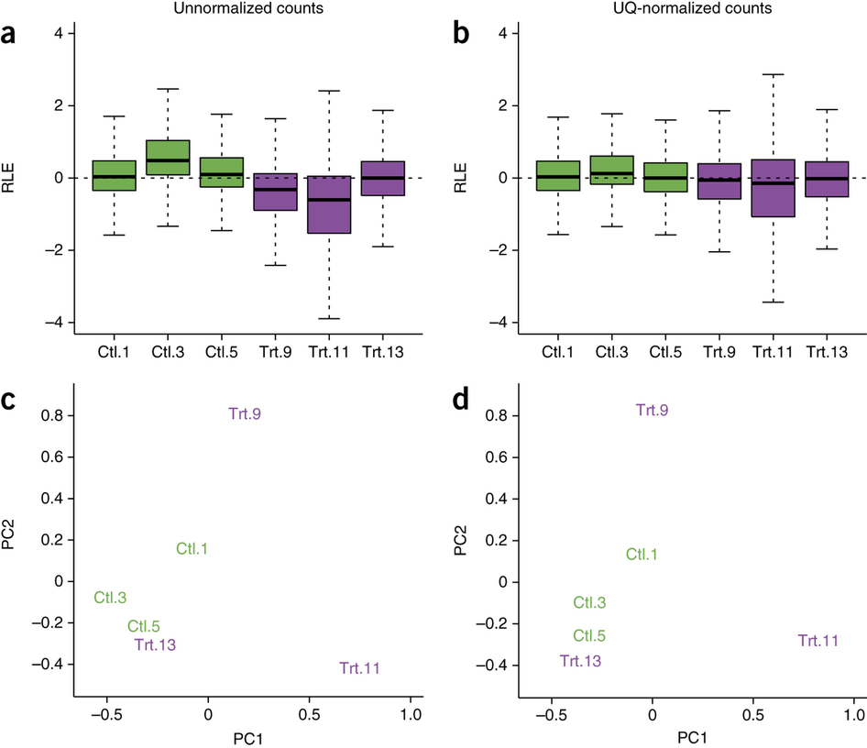
Notes:
Figure 2: Unwanted variation in the zebrafish RNA-seq data set.

Slide 19
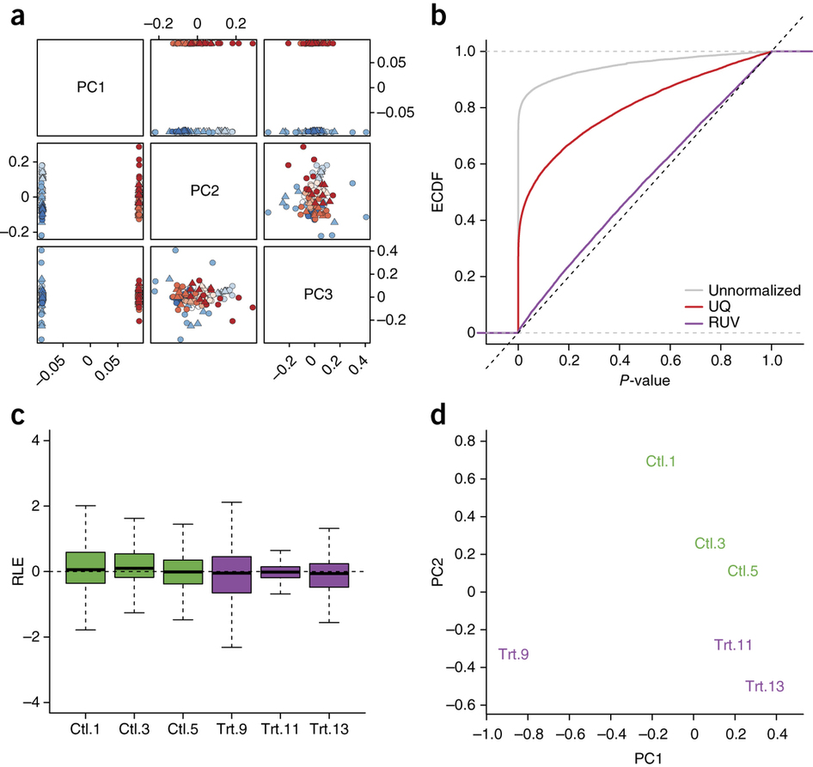
Notes:
Figure 3: RUVg normalization using in silico empirical control genes.

Slide 20
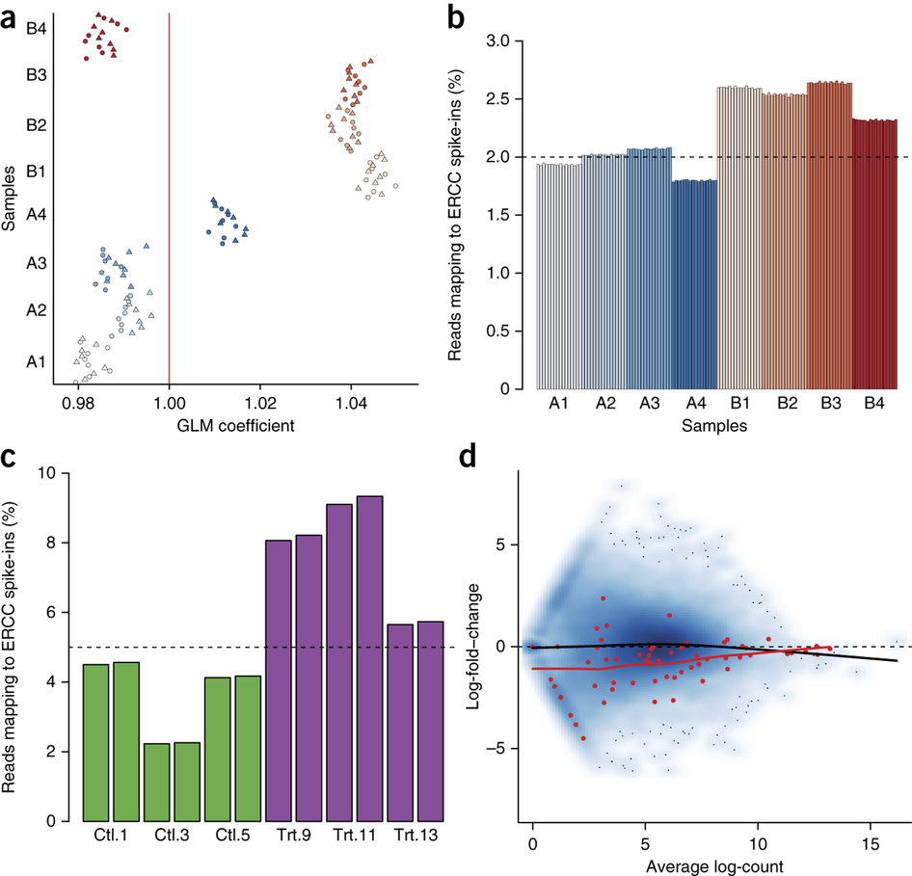
Notes:
Figure 4: Behavior of the ERCC spike-in controls.

Slide 21
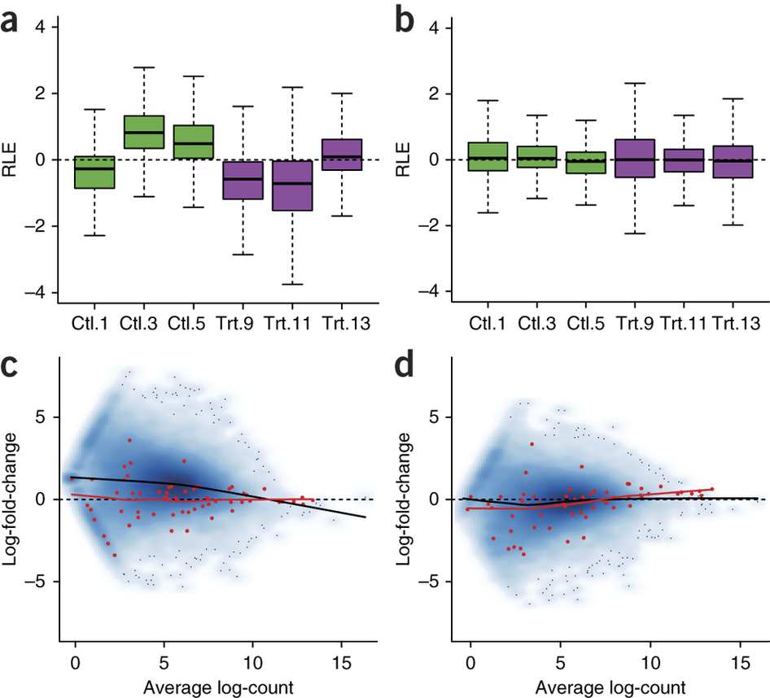
Notes:
Figure 5: Using the ERCC spike-in controls for normalization, zebrafish data set.

Slide 22
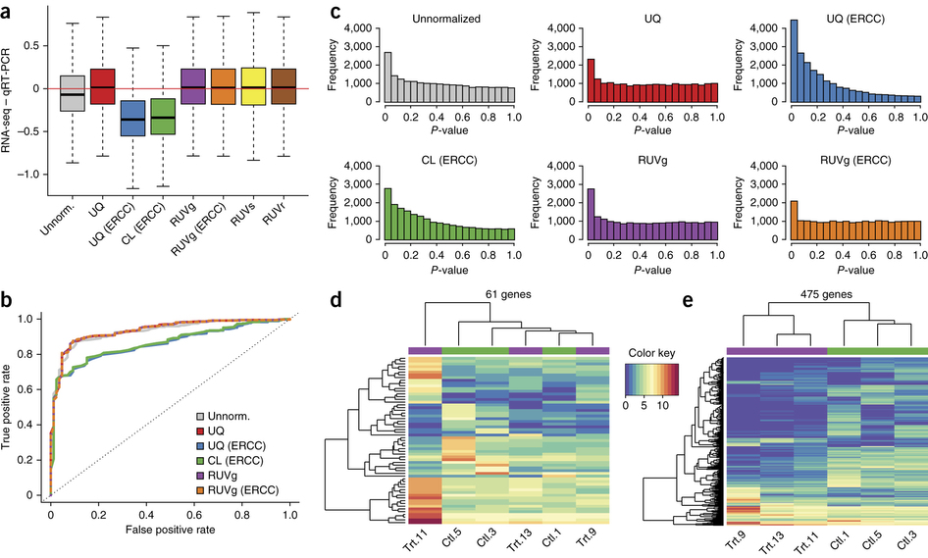
Notes:
Figure 6: Impact of normalization on differential expression analysis.

Slide 23
Normalization
One often overlooked aspect is normalization, which is the transformation of values that allows comparisons between samples in a way that eliminates the effects of sources of variability that are not of interest.
We refer to those effects as ‘unwanted variation’. A variety of technical and biological factors, collectively known as ‘batch effects’, contribute unwanted variation to genome-wide gene expression data.
These factors include differences in amount of RNA, library preparation, equipment, operators, and procedures for sample extraction, preservation, or storage.
Proper normalization, or removal of these factors, has been shown to critically impact the analysis of high-throughput data (1–3). In spite of this, commonly used methods for RNA-seq normalization, such as upper quartile scaling (UQ)(2), trimmed mean of M values (TMM)(4) and FPKM (5), account only for global differences in sequencing depth between libraries (6).
The R code to reproduce all the main figures and tables of the article is available as tutorials in the supplementary material and downloadable form GitHub (github.com/drisso/peixoto2015_tutorial).

Slide 24
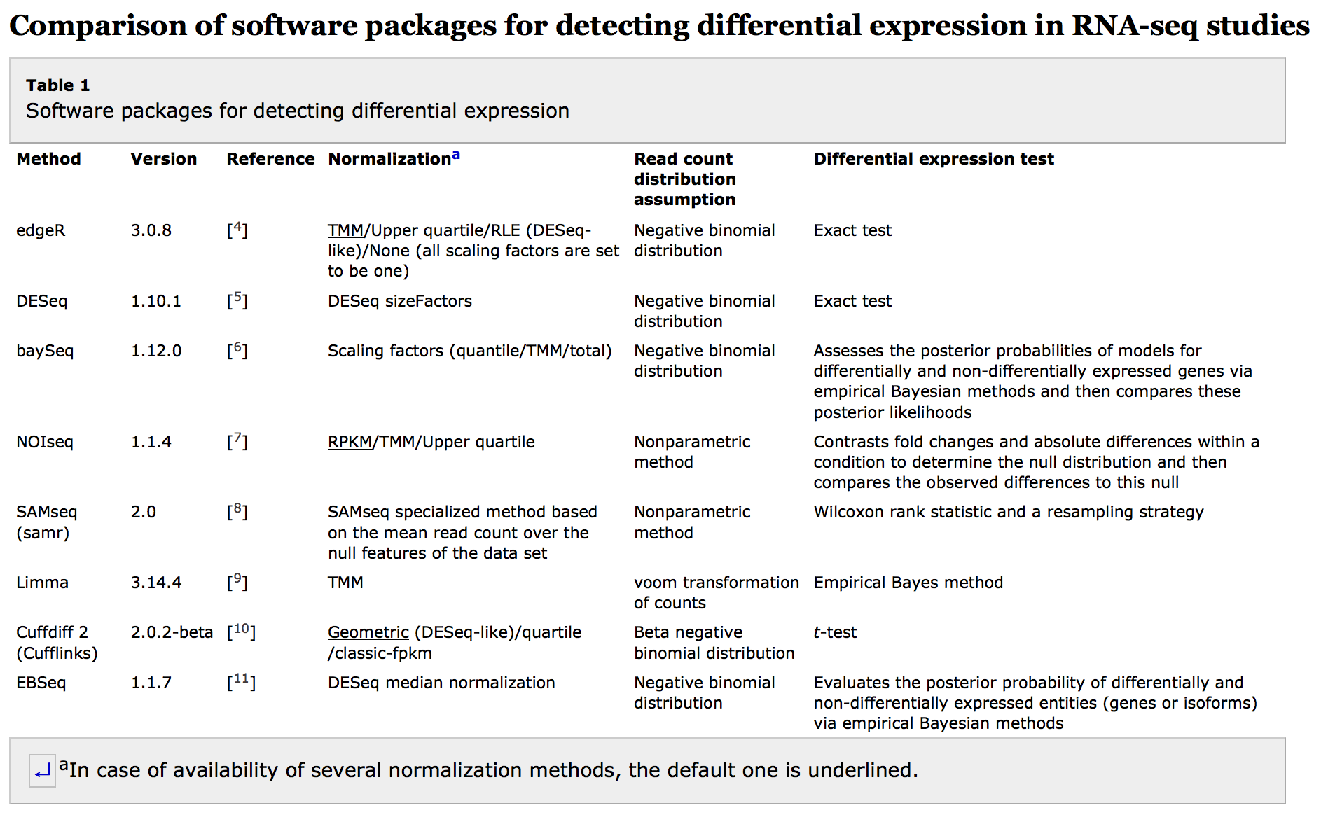

Slide 25
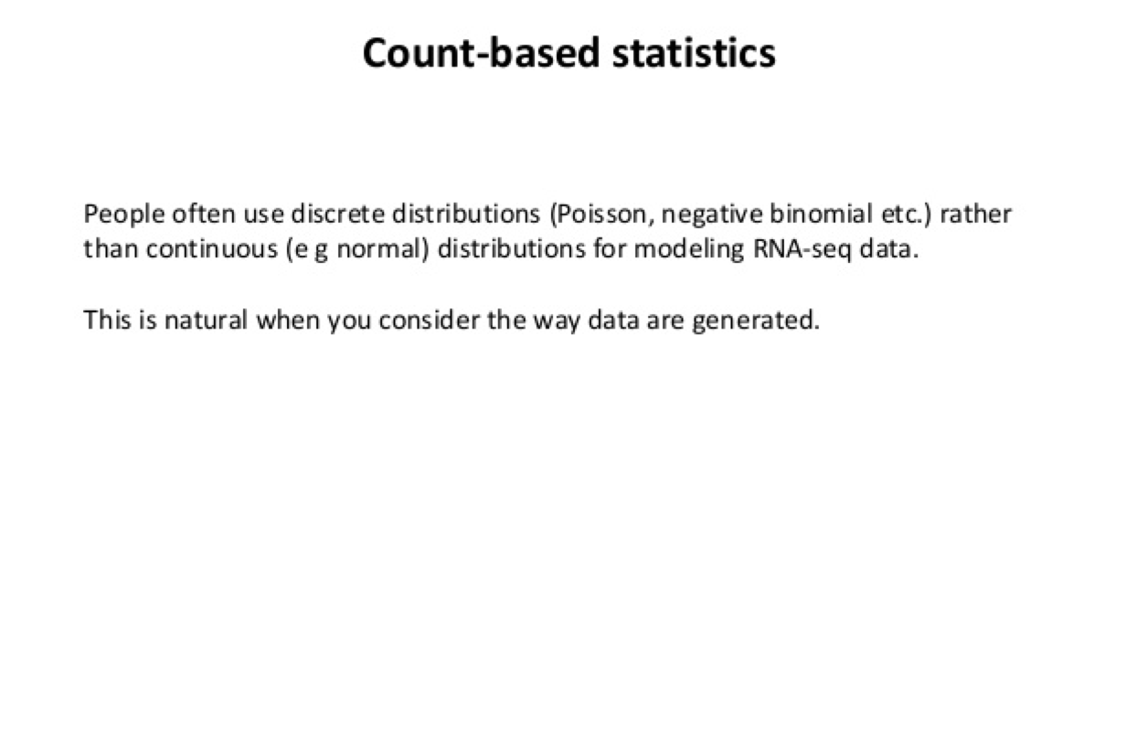
Count Based Statistics

Slide 26
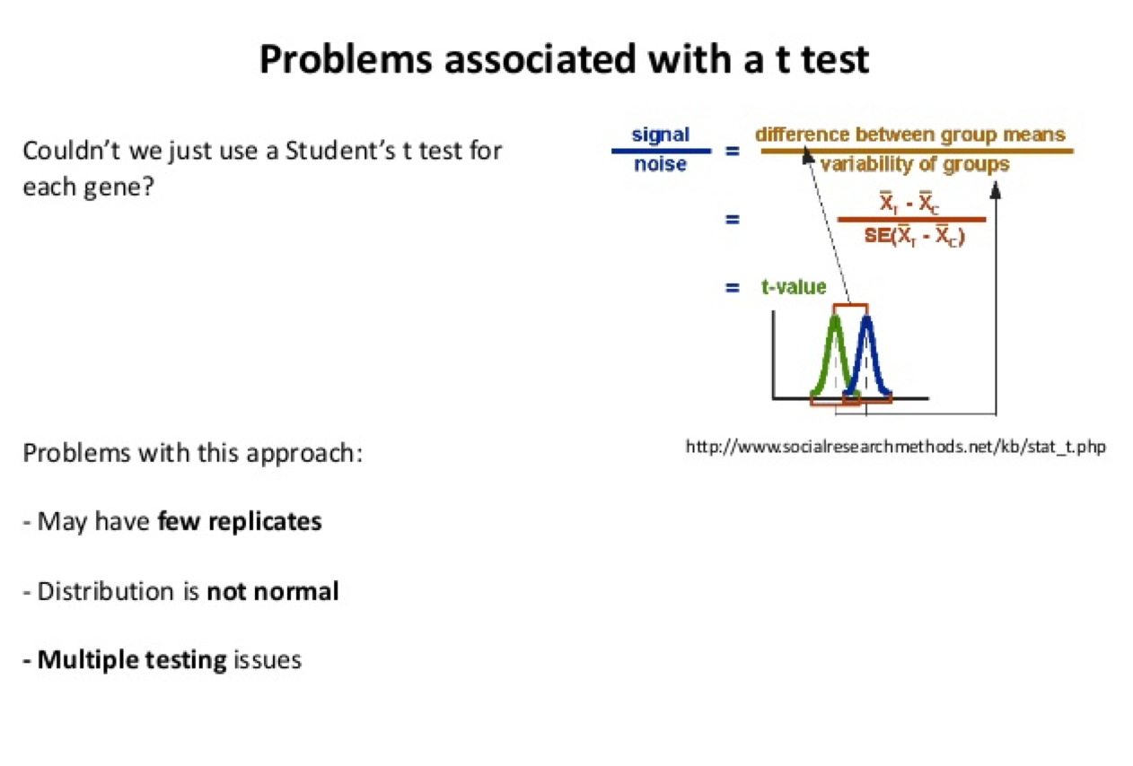

Slide 27
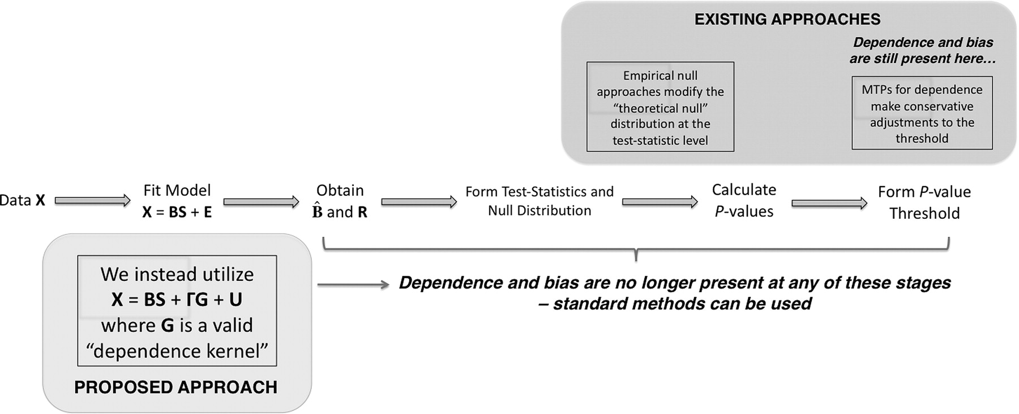
A schematic of the general steps of multiple hypothesis testing.
Jeffrey T. Leek, and John D. Storey PNAS 2008;105:18718-18723
©2008 by National Academy of Sciences
Notes:
A schematic of the general steps of multiple hypothesis testing. We directly account for multiple testing dependence in the model-fitting step, where all the downstream steps in the analysis are not affected by dependence and have the same operating characteristics as independent tests. Our approach differs from current methods, which address dependence indirectly by modifying the test statistics, adaptively modifying the null distribution, or altering significance cutoffs. For these downstream methods the multiple testing dependence is not directly modeled from the data, so distortions of the signal of interest and the null distribution may be present regardless of which correction is implemented.

Slide 28
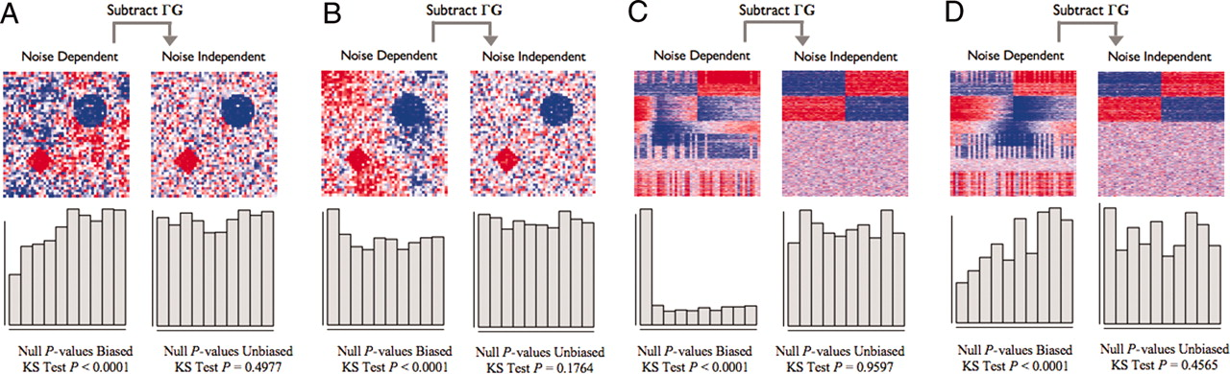
Simulated examples of multiple testing dependence.
Jeffrey T. Leek, and John D. Storey PNAS 2008;105:18718-18723
©2008 by National Academy of Sciences
Notes:
Simulated examples of multiple testing dependence. A and B consist of spatial dependence examples as simplified versions of that encountered in brain imaging, and C and D consist of latent structure examples as encountered in gene expression studies. In all examples, the data and the null P values are plotted both before and after subtracting the dependence kernel. The data are plotted in the form of a heat map (red, high numerical value; white, middle; blue, low). The signal is clearer and the true null tests' P values are unbiased after the dependence kernel is subtracted. (A and B) Each point in the heat map represents the data for one spatial variable. The two true signals are in the diamond and circle shapes, and there is autoregressive spatial dependence between the pixels. (A) An example where the spatial dependence confounds the true signal, and the null P values are anticonservatively biased. (B) An example where the spatial dependence is nearly orthogonal to the true signal, and the null P values are conservatively biased. (C and D) Each row of the heat map corresponds to a gene's expression values, where the first 400 rows are genes simulated to be truly associated with the dichotomous primary variable. Dependence across tests is induced by common unmodeled variables that also influence expression, as described in the text. (C) An example where dependence due to latent structure confounds the true signal, and the null P values are anticonservatively biased. (D) An example where dependence due to latent structure is nearly orthogonal to the true signal, and the null P values are conservatively biased.

Slide 30
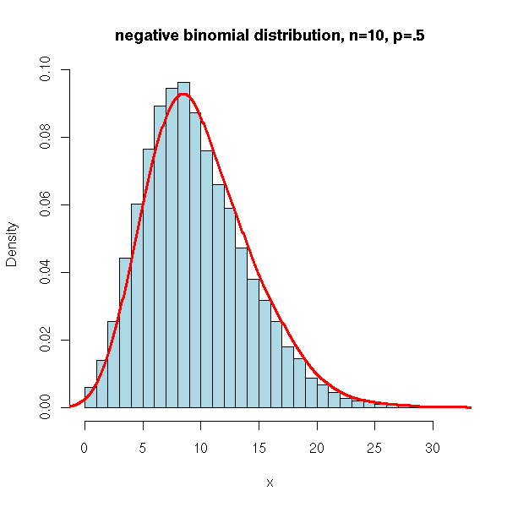

Slide 31
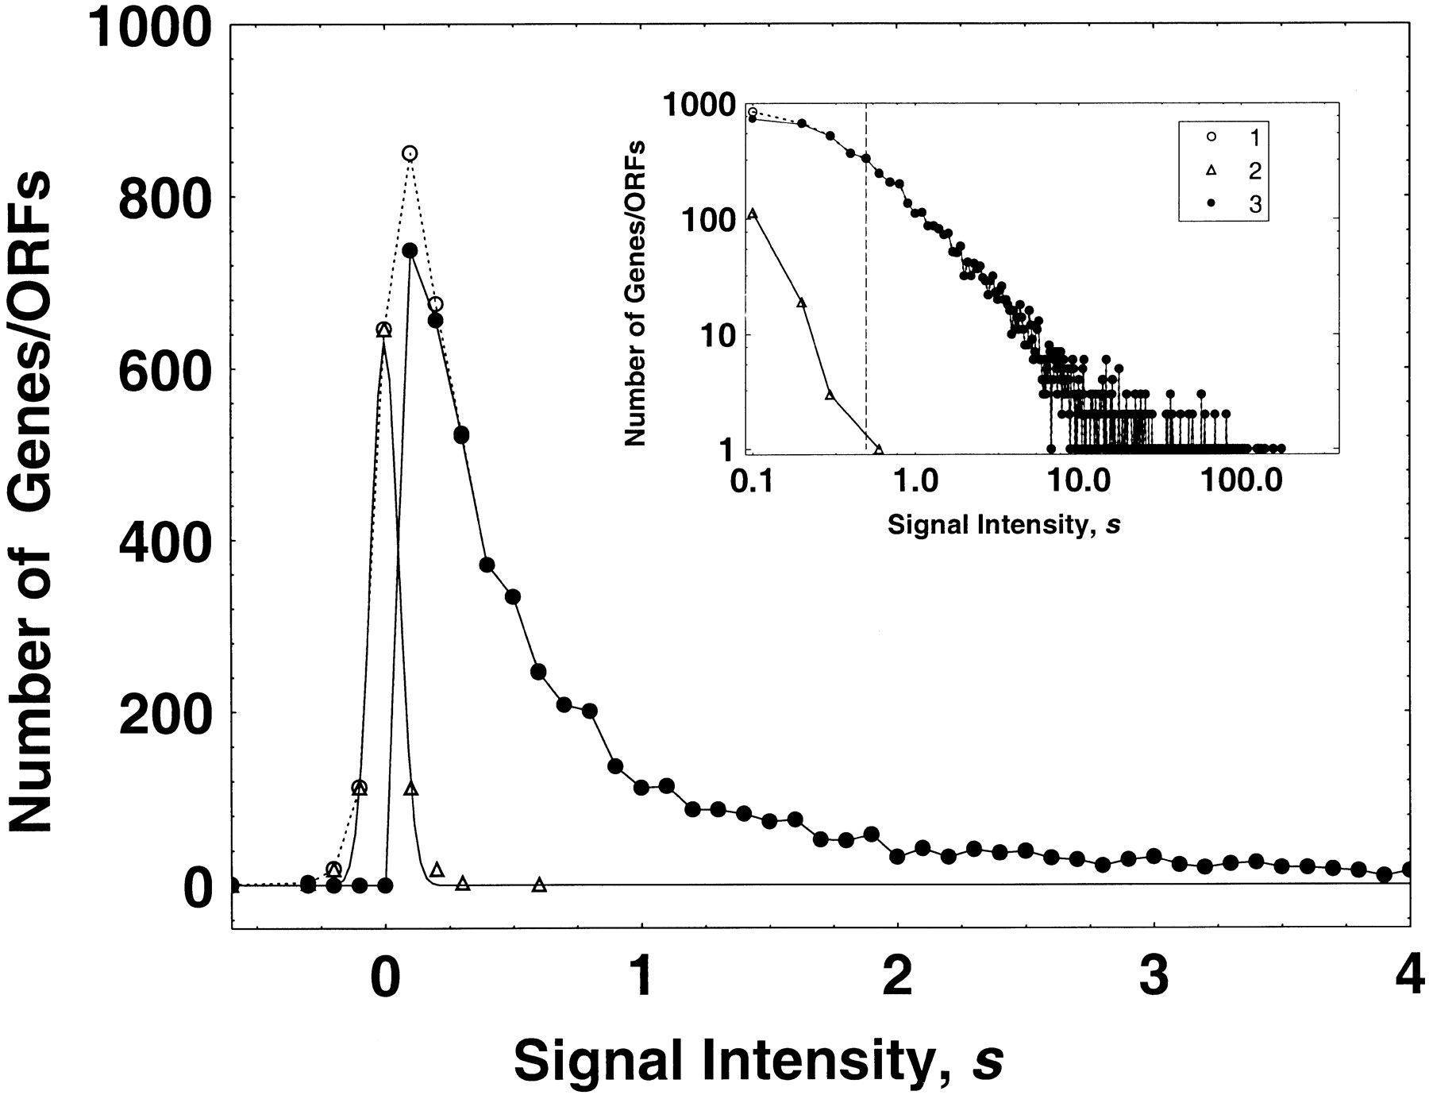

The empirical frequency distribution of the hybridization signal intensity values for Affymetrix microarray hybridization data for normal yeast cell genes/ORFs (Jelinsky and Samson 1999).
Kuznetsov V A et al. Genetics 2002;161:1321-1332
Notes:
The empirical frequency distribution of the hybridization signal intensity values for Affymetrix microarray hybridization data for normal yeast cell genes/ORFs (Jelinsky and Samson 1999). We checked that the background noise intensity signals (▵) were distributed with an approximately normal distribution function with mean zero and standard deviation 0.054. Intensity signal distribution before (○) and after (●) subtraction of the background noise from the signal values is shown. The total hybridization signal intensity has been normalized (by Jelinsky and Samson 1999) with respect to the mean number of mRNA molecules per yeast cell. A point (s, f(s)) on the major plot shows the number of genes/ORFs, f, which have the signal intensity value, s. The vertical discontinuous line indicates the lower bound of the “reliably” detectable intensity signal values (the lower bound corresponds to 0.5 transcripts per cell). The window plot (log-log plot) shows the signal intensity distributions before and after subtraction of noise, shown over the full range of the positive signal intensity values.

Slide 32
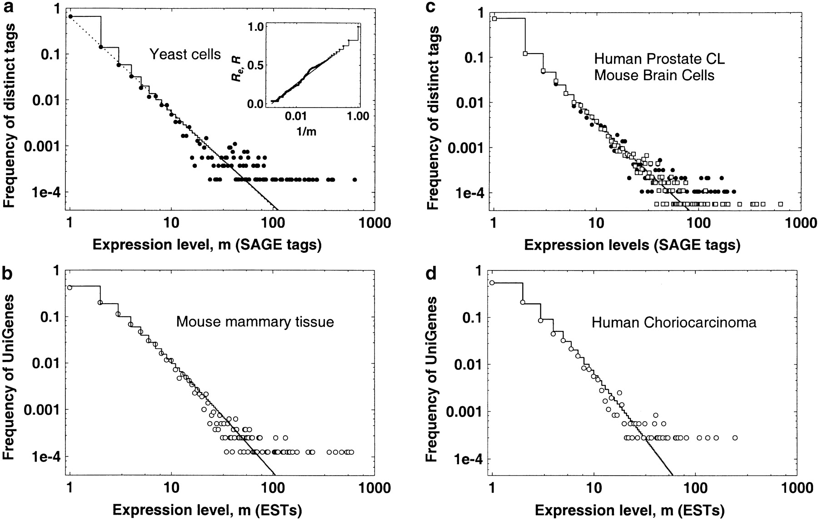
Empirical relative frequency distributions of the gene expression levels.
Kuznetsov V A et al. Genetics 2002;161:1321-1332
Notes:
Empirical relative frequency distributions of the gene expression levels. Log-log plots are shown. (a) ●, log-phase yeast cell growth library with 20,096 SAGE tags; solid step-function line, GDP model with k = 0.974 ± 0.004, b = −0.173 ± 0.004; dotted line, simple power law with k = 1.03 ± 0.005. Inset plot: ●, empirical cumulative fraction function R_{e} values [ ]for the ● histogram (main plot); the solid line is the corresponding theoretical model computed by the GDP model (main plot). (Cumulative data reduce the apparent “noise” in the histogram data.) (b) ○, mouse mammary cells cDNA library 341 of size 36,675 ESTs; solid step-function line, GDP model with k = 1.44 ± 0.006, b = 1.34 ± 0.002. (c) ●, human colon cancer cells SAGE library 2892.2 of size 22,637 tags; solid step-function line, GDP model for ● data at k = 1.08 ± 0.030, b = −0.28 ± 0.010; □, mouse brain (primary meduloblastoma) cells SAGE library 3871 of size 43,274 tags. (d) ○, human choriocarcinoma cells cDNA library 2427 of size 10,087 ESTs; solid step-function line, GDP model with k = 1.88 ± 0.044, b = 1.34 ± 0.005.

Slide 33
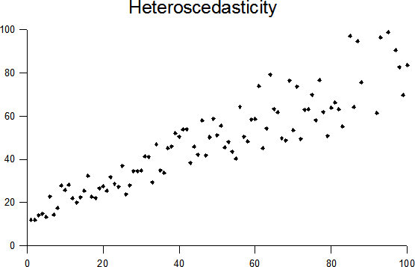

Slide 34


Slide 35
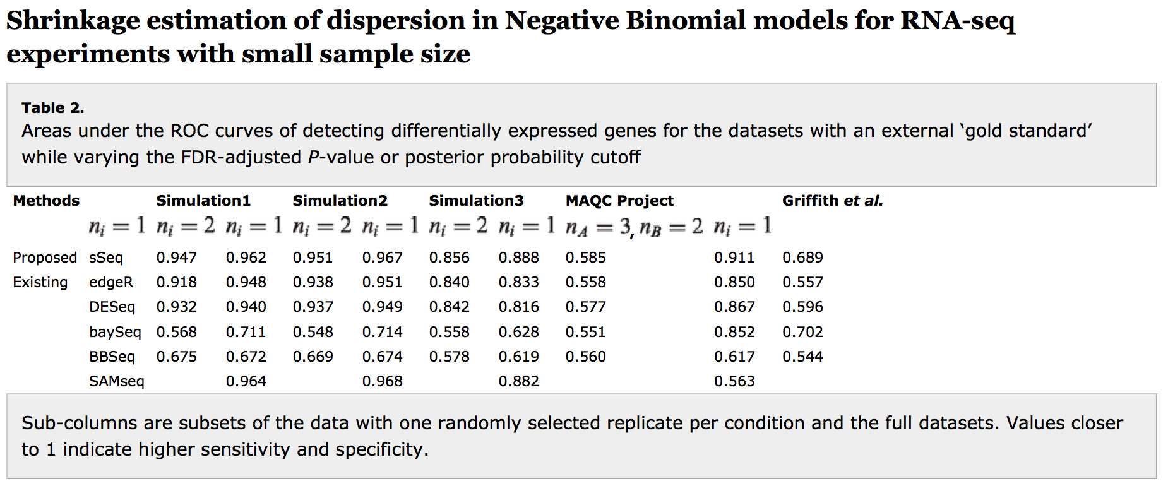

Slide 36
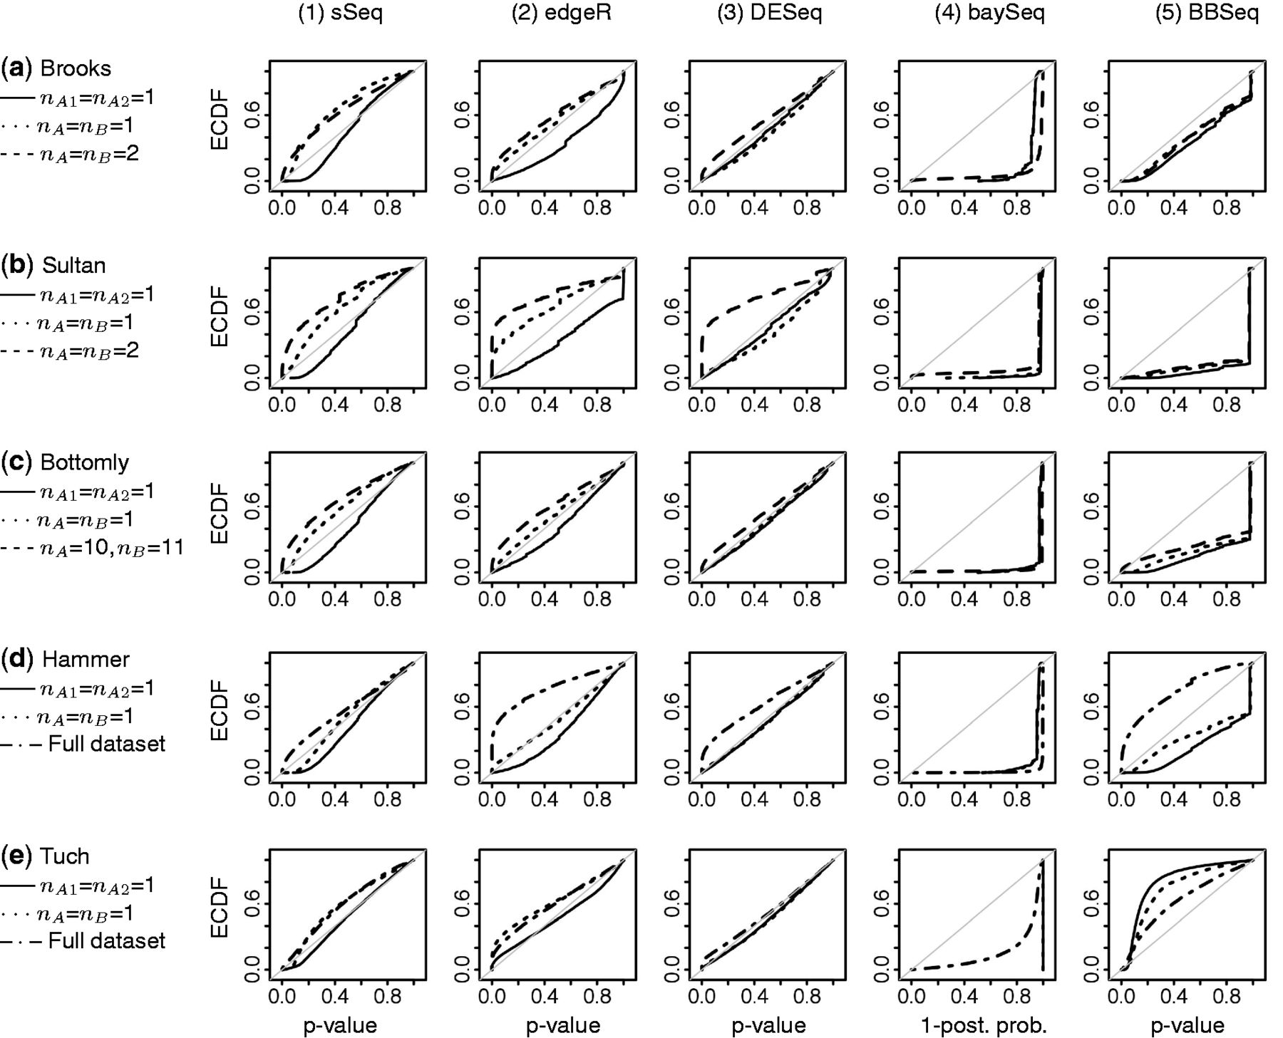

The ECDF curves of detecting differential expression for the datasets with no external ‘gold standard’.
Danni Yu et al. Bioinformatics 2013;29:1275-1282
© The Author 2013. Published by Oxford University Press.
Notes:
The ECDF curves of detecting differential expression for the datasets with no external ‘gold standard’. Y-axis: ECDF, function of the gene rank. x-axis: P-value or 1 minus posterior probability. Solid line: two randomly selected replicates from a same condition (AvsA). Dotted line: one randomly selected replicate from each condition (unreplicated AvsB). Dashed line: AvsB on the full dataset for two-group designs. Dashed-dotted line: AvsB on the full dataset for more complex designs. Gray line: 45 degree. SAMseq is not applicable to unreplicated experiments and is excluded. The desired patterns are high areas under the AvsB curves, and AvsA curves that are at or below the 45 degree line

Slide 37
Multiple Biological Replicates Are Necessary
sSeq can produce meaningful results in under-replicated RNA-seq screens.
However, we stress that RNA-seq screens do not eliminate the biological variation in gene expression Equation (12).
As evidenced by Table 2 and Figure 2, the under-replicated screens have lower reproducibility as compared with the replicated studies.
Multiple biological replicates are necessary to adequately assess the full extent of the variation in the biological system.
Therefore, the under-replicated screens can only be conducted when followed by a rigorous experimental validation with complementary technologies and adequate sample size.

Slide 38
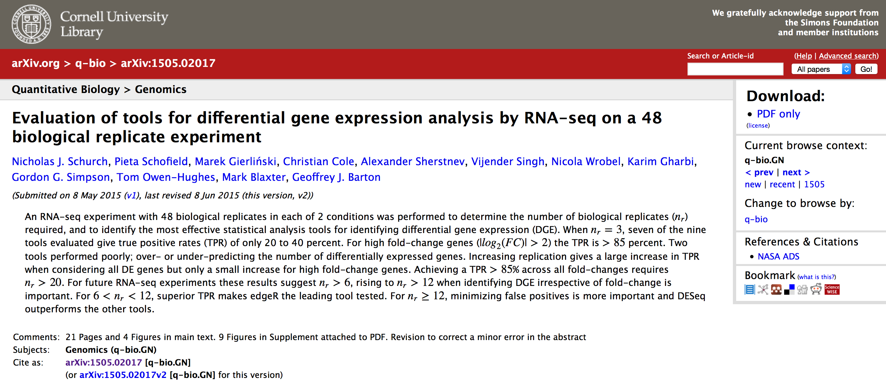
Experimental Design: Recommended Software
Notes:
http://arxiv.org/ftp/arxiv/papers/1505/1505.02017.pdf

Slide 39
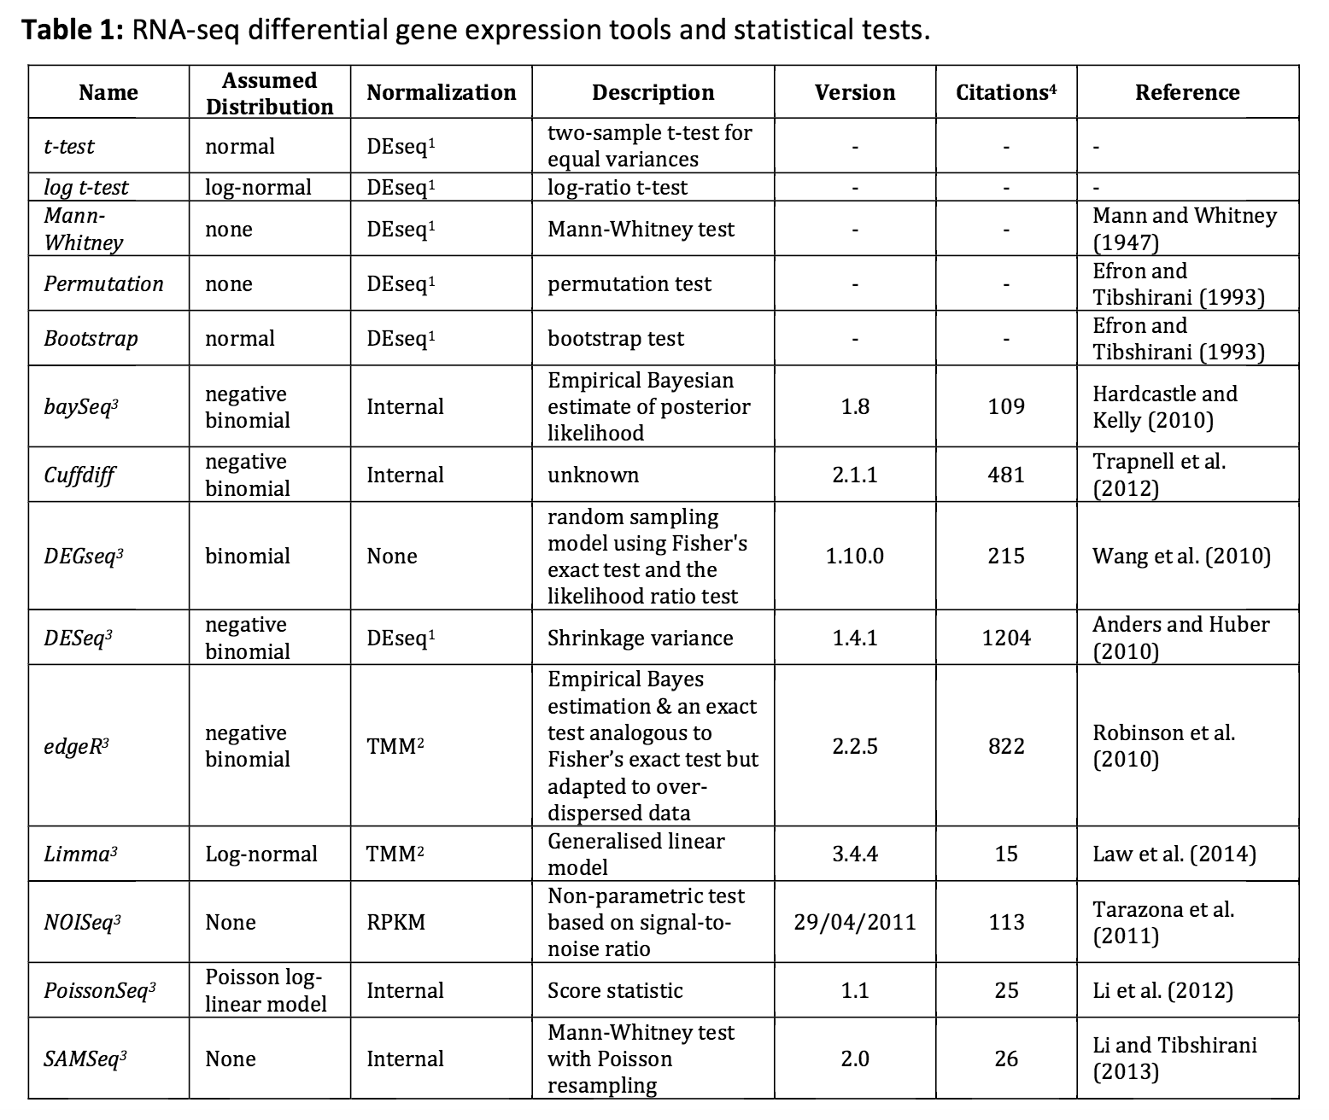
Experimental Design: Recommended Software
Notes:
http://arxiv.org/ftp/arxiv/papers/1505/1505.02017.pdf

Slide 40
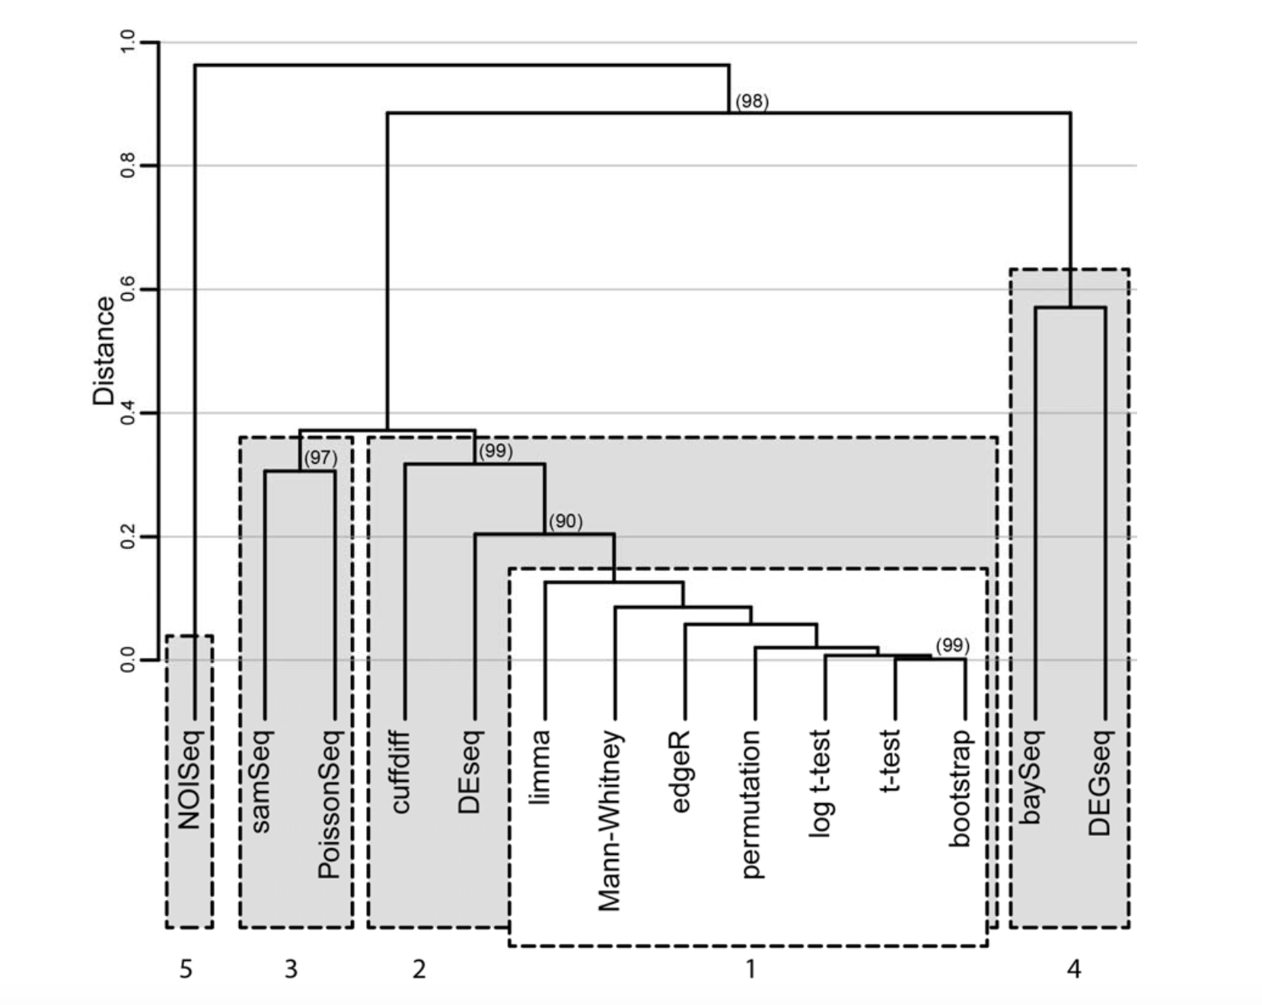
Experimental design: recommended softwares
Notes:
http://arxiv.org/ftp/arxiv/papers/1505/1505.02017.pdf

Slide 41
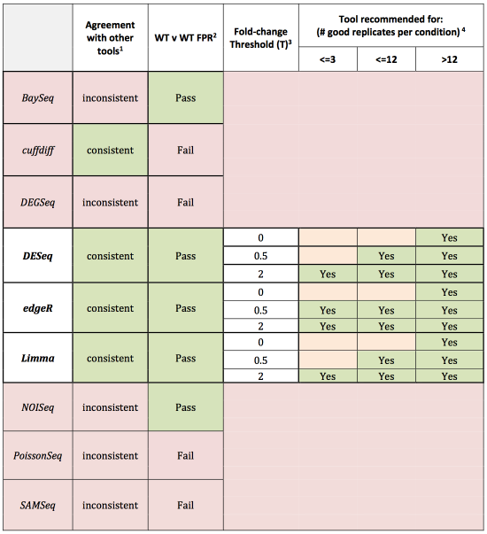

Slide 42
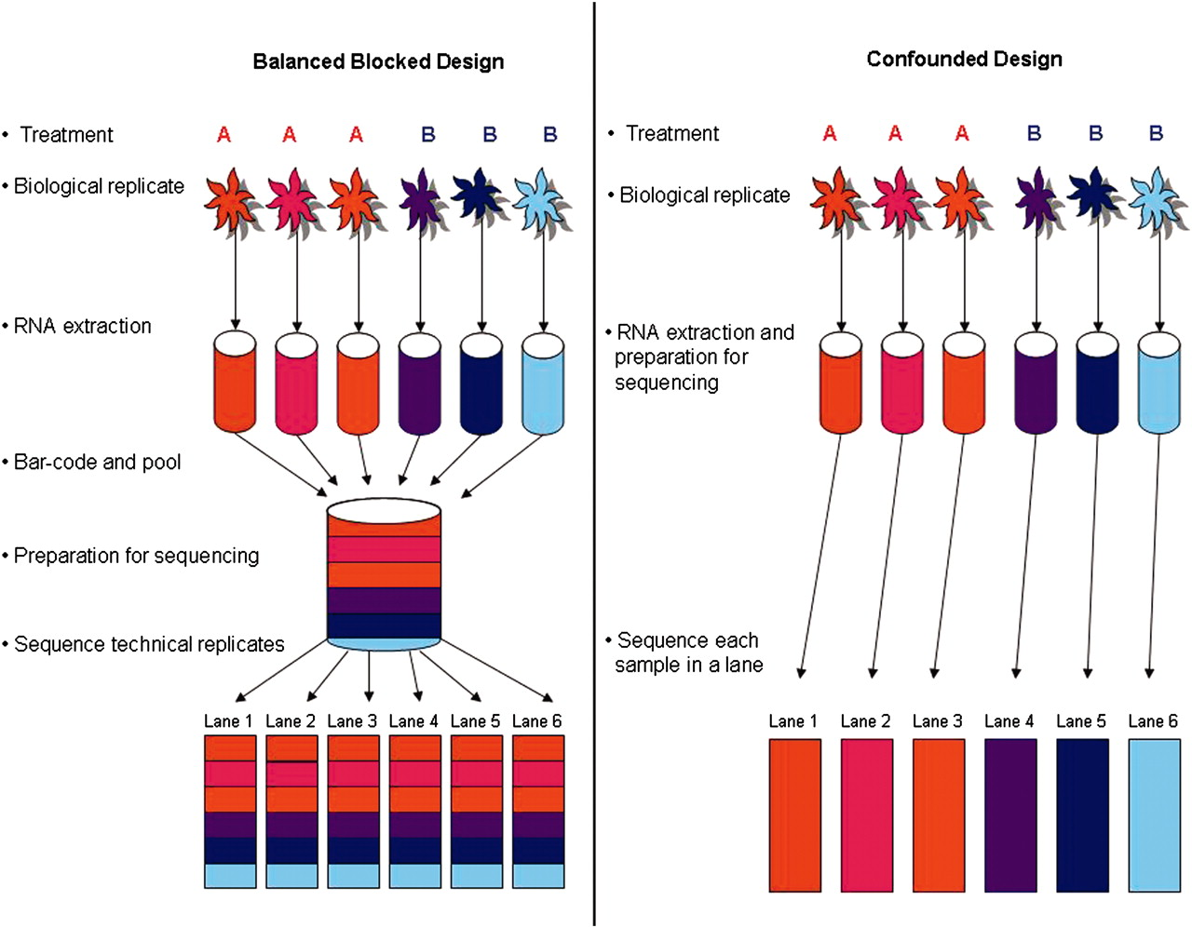
Comparison of two designs for testing differential expression between treatments A and B. Treatment A is denoted by red tones and treatment B by blue tones.
Paul L. Auer, and R. W. Doerge Genetics 2010;185:405-416
Notes:
Comparison of two designs for testing differential expression between treatments A and B. Treatment A is denoted by red tones and treatment B by blue tones. In the ideal balanced block design (left), six samples \batchmode \documentclass[fleqn,10pt,legalpaper]{article} \usepackage{amssymb} \usepackage{amsfonts} \usepackage{amsmath} \pagestyle{empty} \begin{document} \((m{=}6)\) \end{document} are bar coded, pooled, and processed together. The pool is then divided into six equal portions that are input to six lanes \batchmode \documentclass[fleqn,10pt,legalpaper]{article} \usepackage{amssymb} \usepackage{amsfonts} \usepackage{amsmath} \pagestyle{empty} \begin{document} \((L{=}6)\) \end{document} of the flow cell. Bar coding in the balanced block design results in six technical replicates \batchmode \documentclass[fleqn,10pt,legalpaper]{article} \usepackage{amssymb} \usepackage{amsfonts} \usepackage{amsmath} \pagestyle{empty} \begin{document} \((T{=}6)\) \end{document} of each sample, while balancing batch and lane effects and blocking on lane. The balanced block design also allows partitioning of batch and lane effects from the within-group biological variability. The confounded design (right) represents a typical RNA-Seq experiment and consists of the same six samples, with no bar coding, and does not permit partitioning of batch and lane effects from the estimate of within-group biological variability.

Slide 43
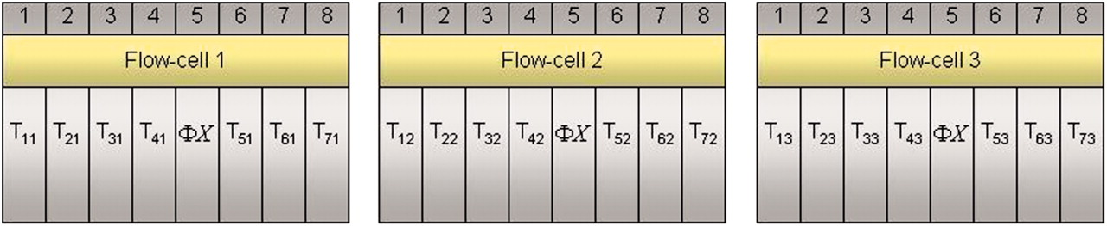
A multiple flow-cell design based on three biological replicates within seven treatment groups.
Paul L. Auer, and R. W. Doerge Genetics 2010;185:405-416
Notes:
A multiple flow-cell design based on three biological replicates within seven treatment groups. There are three flow cells with eight lanes per flow cell. The control \batchmode \documentclass[fleqn,10pt,legalpaper]{article} \usepackage{amssymb} \usepackage{amsfonts} \usepackage{amsmath} \pagestyle{empty} \begin{document} \({\Phi}X\) \end{document} sample is in lane 5 of each flow cell. Tij refers to the \batchmode \documentclass[fleqn,10pt,legalpaper]{article} \usepackage{amssymb} \usepackage{amsfonts} \usepackage{amsmath} \pagestyle{empty} \begin{document} \(j\mathrm{th}\) \end{document} replicate in the \batchmode \documentclass[fleqn,10pt,legalpaper]{article} \usepackage{amssymb} \usepackage{amsfonts} \usepackage{amsmath} \pagestyle{empty} \begin{document} \(i\mathrm{th}\) \end{document} treatment group \batchmode \documentclass[fleqn,10pt,legalpaper]{article} \usepackage{amssymb} \usepackage{amsfonts} \usepackage{amsmath} \pagestyle{empty} \begin{document} \((i{=}1,{\ldots},{\,}7;j{=}1,{\ldots},{\,}3)\) \end{document}.

Slide 44
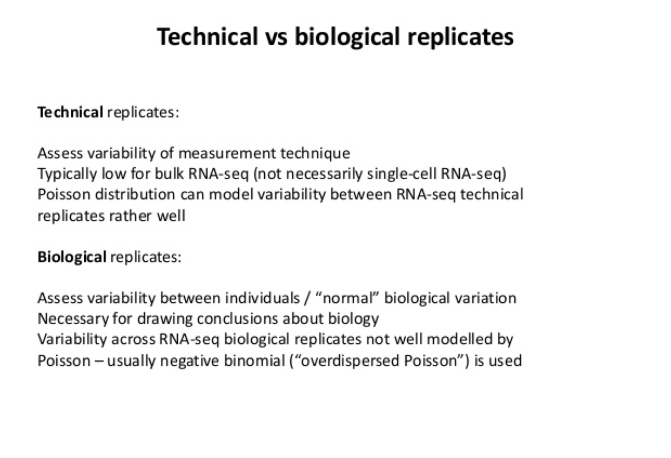

Slide 45
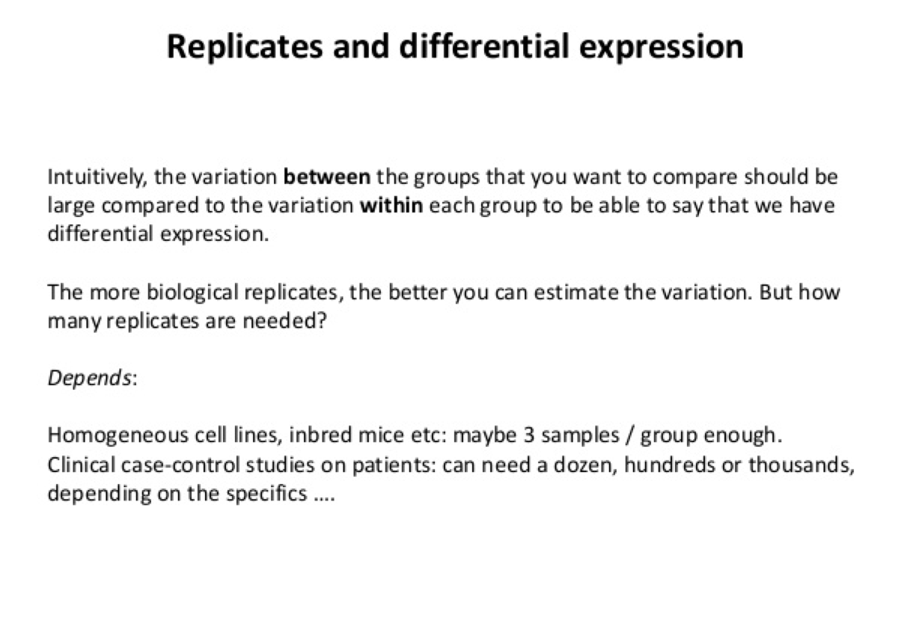

Slide 46
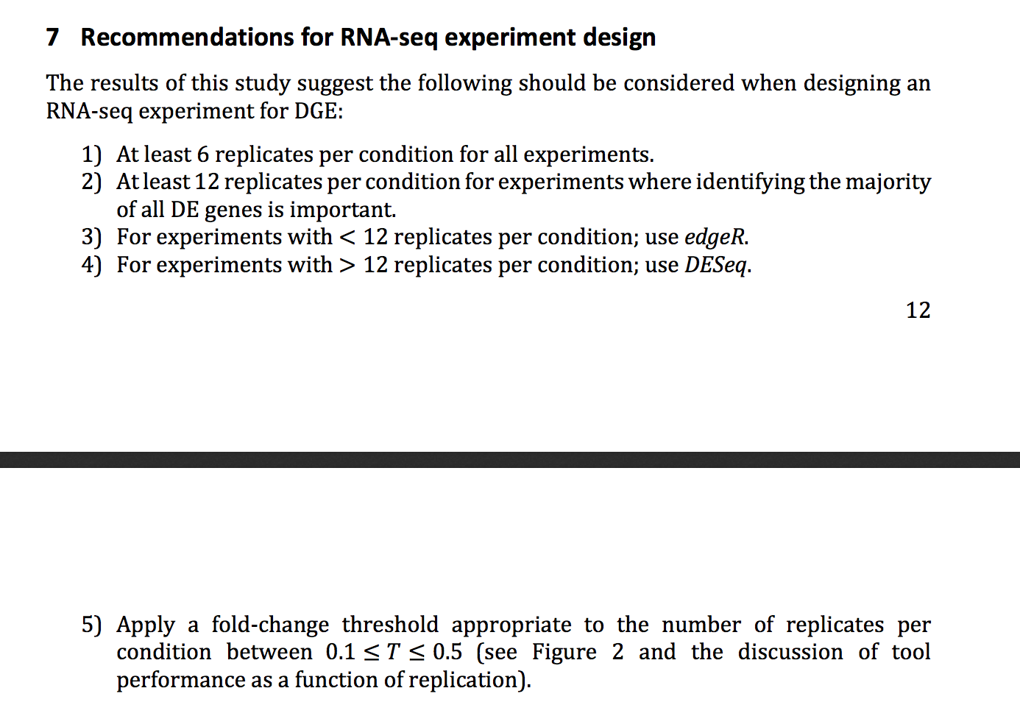

Slide 47

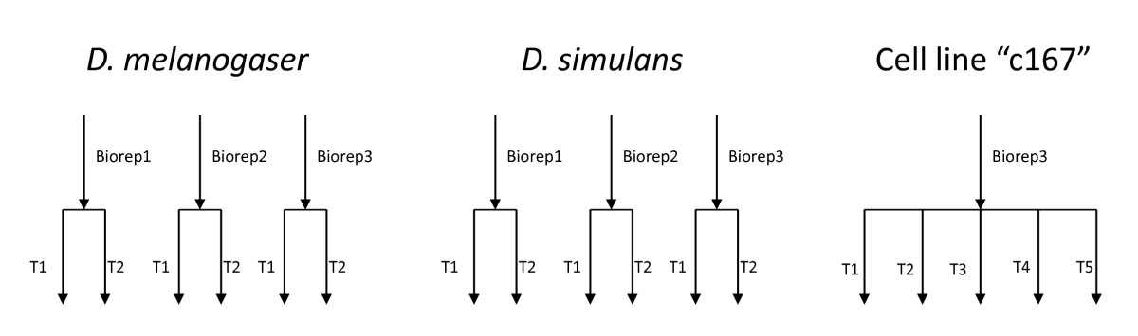
Notes:
Figure 1 Experimental Design. A figure showing the design of the three experiments evaluated here. Biological replicates are separate individuals used for library construction. Technical replicates for the D. melanogaster female heads and D. simulans male heads data are a single library run on multiple lanes. For D. melanogaster c167 cell lines the exact nature of the technical replication is uncertain.

Slide 48
A “Good” Lane Has ~30 Million Clusters. This Represents 0.0013 % Of The Starting Library
The number of molecules present in the library is estimated to be 2.408 × 1012.
This estimate was derived using the Illumina protocol. Specifically, the starting material was assumed to be 100 ng of mRNA that then resulted in 500 ng of library with an insert size of 250bp in a volume of 400 uL for a final library concentration of 10 nM.
The number of pmoles is therefore 4 [(10 nmol/1L) (1L/1000 mL)(1 mL/1000 uL)(400 uL)(1000 pmol/1 nmol)].
The number of molecules is found by multiplying Avogadro's number which is molecules/moles and adjusting for units [4 pmole)/1000/1000/1000/1000*6.02E + 023] to give 2.408 × 1012 molecules.
On the current Solexa/Illumina technology, the GAIIx, approximately 30 million of the total possible molecules are sampled in a given lane. This represents approximately 0.0013% (30,000,000/2.408 × 1012) of the total number of available molecules for analysis (Figure 2).

Slide 49
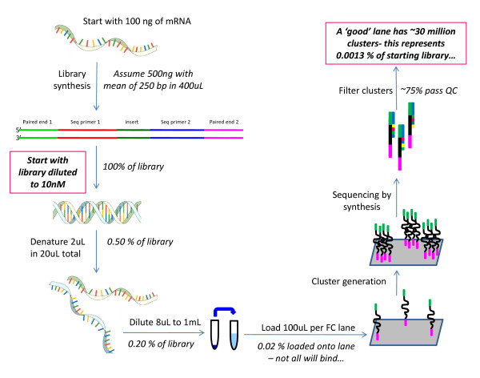
Notes:
Figure 2 Library construction and sequencing. Beginning with 100 ng of mRNA the manufacturer's protocol is used to estimate a sampling fraction.

Slide 51
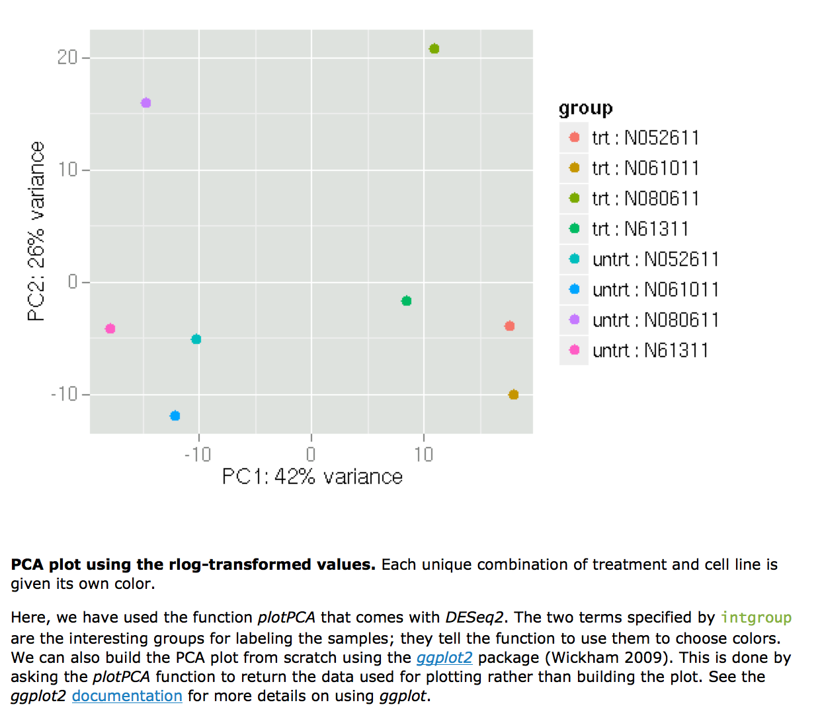
Intro to SVA

Slide 52
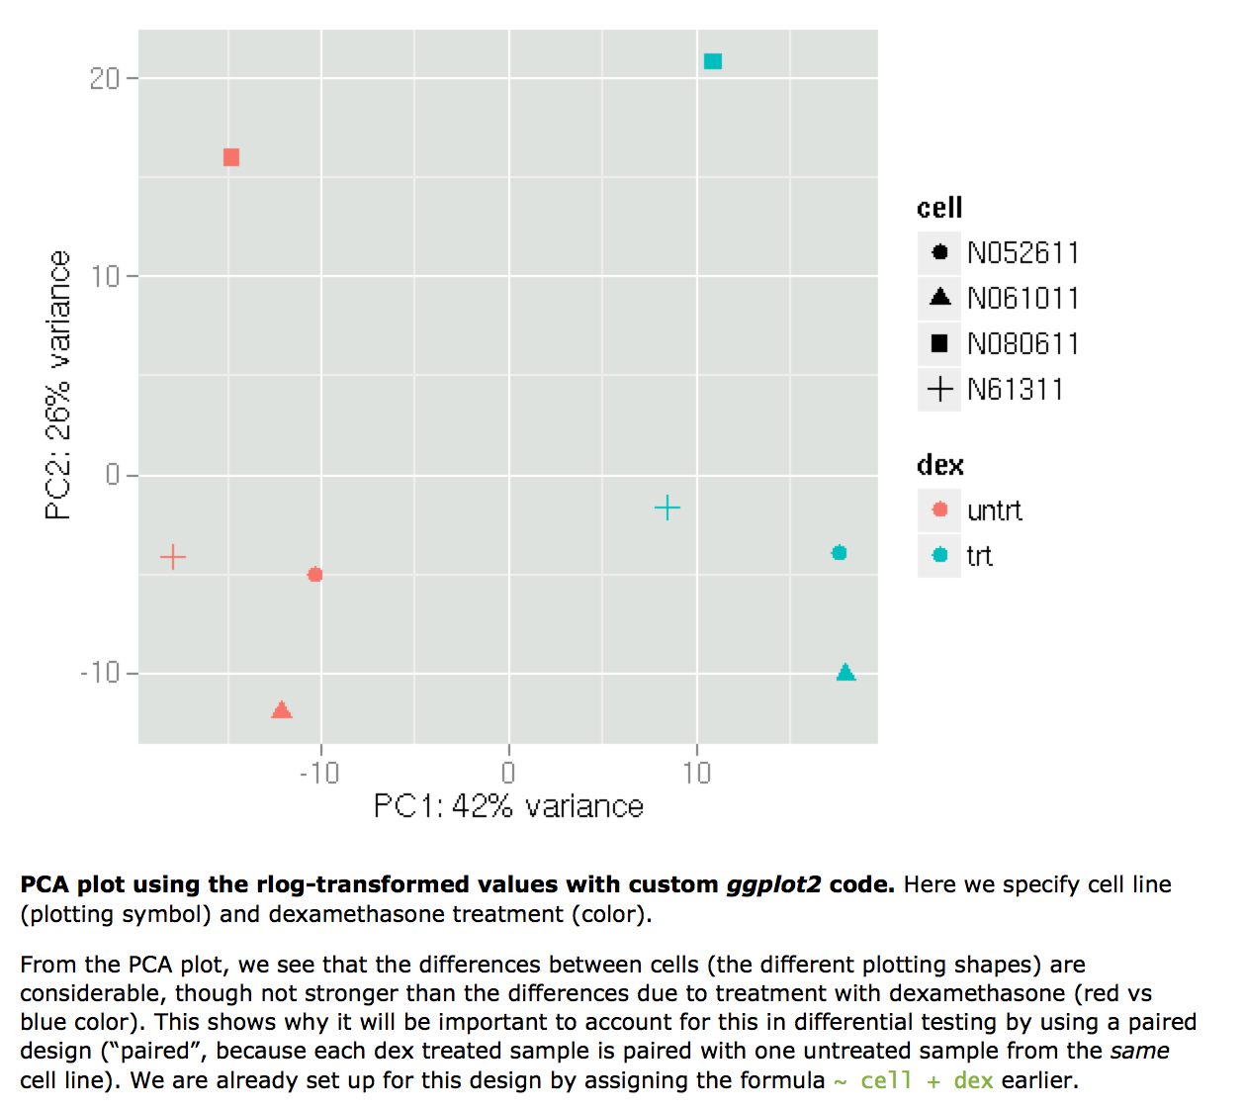
Intro to SVA

Slide 53
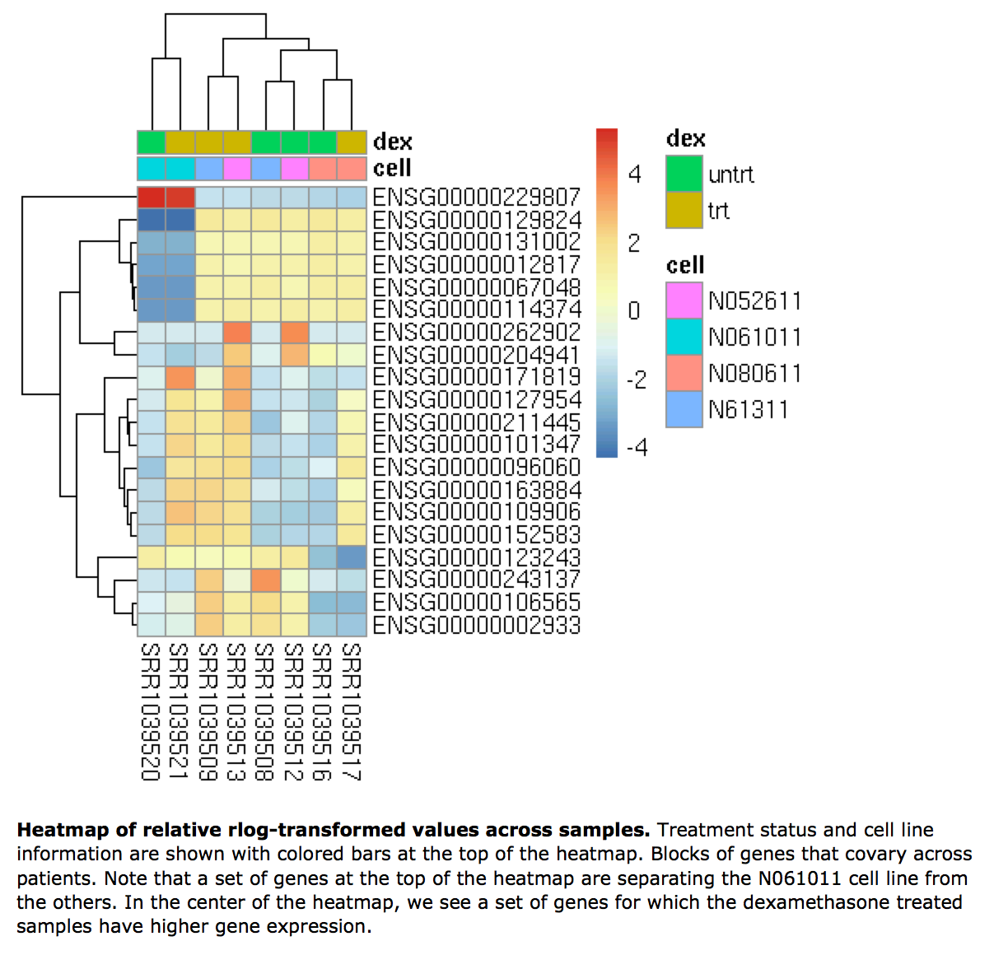
Intro to SVA

Slide 54
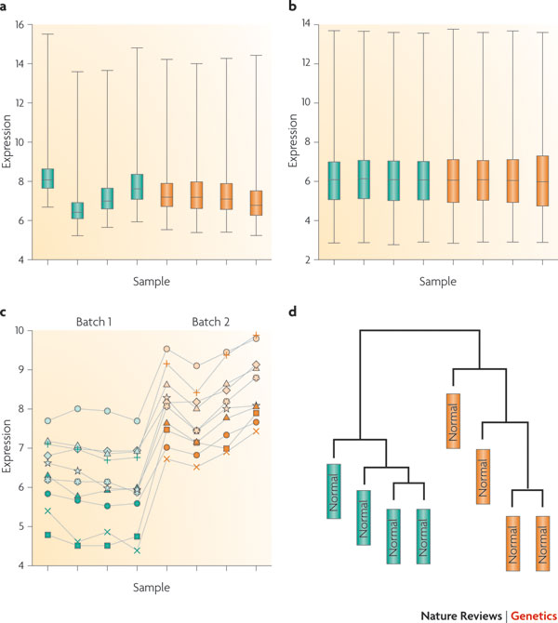
Notes:
Figure 1 | Demonstration of normalization and surviving batch effects.
For a published bladder cancer microarray data set obtained using an Affymetrix platform⁹, we obtained the raw data for only the normal samples. Here, green and orange represent two different processing dates. a | Box plot of raw gene expression data (log base 2). b | Box plot of data processed with RMA, a widely used preprocessing algorithm for Affymetrix data²⁷. RMA applies quantile normalization — a technique that forces the distribution of the raw signal intensities from the microarray data to be the same in all samples²⁸. c | Example of ten genes that are susceptible to batch effects even after normalization. Hundreds of genes show similar behaviour but, for clarity, are not shown. d | Clustering of samples after normalization. Note that the samples perfectly cluster by processing date.

Slide 55
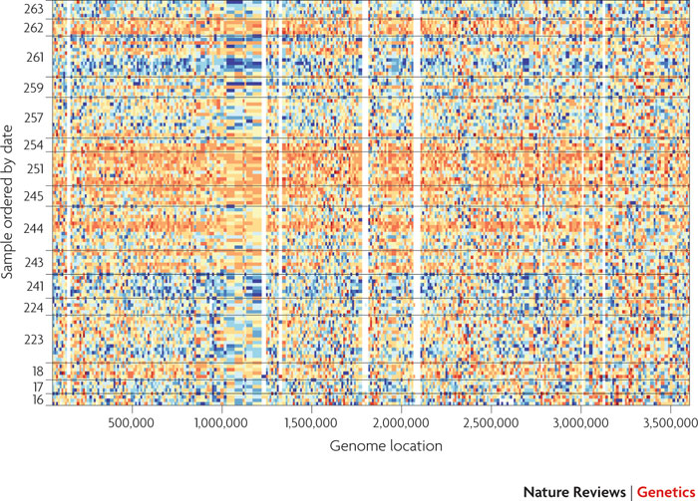
Notes:
igure 2 | Batch effects for second-generation sequencing data from the 1000 Genomes Project.
Each row is a different HapMap sample processed in the same facility with the same platform. See Supplementary information S1 (box) for a description of the data represented here. The samples are ordered by processing date with horizontal lines dividing the different dates. We show a 3.5 Mb region from chromosome 16. Coverage data from each feature were standardized across samples: blue represents three standard deviations below average and orange represents three standard deviations above average. Various batch effects can be observed, and the largest one occurs between days 243 and 251 (the large

Slide 56
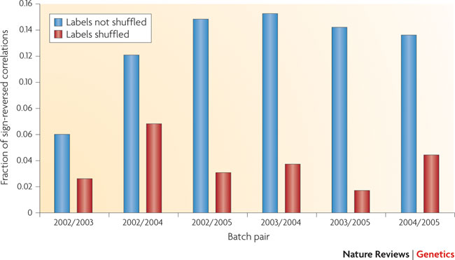
Notes:
Figure 3 | Batch effects also change the correlations between genes.
We normalized every gene in the second gene expression data set² in Table 1 to mean 0, variance 1 within each batch. (The 2006 batch was omitted owing to small sample size.) We identified all significant correlations (p < 0.05) between pairs of genes within each batch using a linear model. We looked at genes that showed a significant correlation in two batches and counted the fraction of times that the correlation changed between the two batches. A large percentage of significant correlations reversed signs across batches, suggesting that the correlation structure between genes changes substantially across batches. To confirm this phenomenon is due to batch, we repeated the process — looking for significant correlations that changed sign across batches — but with the batch labels randomly permuted. With random batches, a much smaller fraction of significant correlations change signs. This suggests that correlation patterns differ by batch, which would affect rank-based prediction methods as well as system biology approaches that rely on between-gene correlation to estimate pathways.

Slide 57


Slide 58

Intro to sva

Slide 59

sva

Slide 60


Figure 1. Impact of Expression Heterogeneity
Leek JT, Storey JD (2007) Capturing Heterogeneity in Gene Expression Studies by Surrogate Variable Analysis. PLoS Genet 3(9): e161. doi:10.1371/journal.pgen.0030161
http://journals.plos.org/plosgenetics/article?id=info:doi/10.1371/journal.pgen.0030161

Slide 61

Figure 2. Example of Expression Heterogeneity
Leek JT, Storey JD (2007) Capturing Heterogeneity in Gene Expression Studies by Surrogate Variable Analysis. PLoS Genet 3(9): e161. doi:10.1371/journal.pgen.0030161
http://journals.plos.org/plosgenetics/article?id=info:doi/10.1371/journal.pgen.0030161

Slide 63


Slide 64

Distribution of means and variances for simulated and real Zebrafish data.
Jeffrey T. Leek Nucl. Acids Res. 2014;nar.gku864
Notes:
Distribution of means and variances for simulated and real Zebrafish data. To confirm that my simulation procedure produced reasonable simulated counts, I plotted the gene-specific means and variances for (left panel) the simulated data set and (right panel) the observed Zebrafish data set. The two distributions are qualitatively similar. Additional checks on the simulation procedure are provided in the simulated data analysis at http://jtleek.com/svaseq/simulateData.html.

Slide 65

Correlation between simulated batch and group variables and various batch estimates.
Jeffrey T. Leek Nucl. Acids Res. 2014;nar.gku864
Notes:
Correlation between simulated batch and group variables and various batch estimates. Light circles indicate low correlation and dark, tight ellipses indicate high correlation. In this case, all estimates that respect multiple sources of signal (sva and RUV based) methods are highly correlated with the simulated batch effect. Principal components estimates a linear combination of the group and batch variable and has lower concordance with the true simulated batch and the other estimates. Additional details at http://jtleek.com/svaseq/simulateData.html.

Slide 66
Normalization
One often overlooked aspect is normalization, which is the transformation of values that allows comparisons between samples in a way that eliminates the effects of sources of variability that are not of interest.
We refer to those effects as ‘unwanted variation’. A variety of technical and biological factors, collectively known as ‘batch effects’, contribute unwanted variation to genome-wide gene expression data.
These factors include differences in amount of RNA, library preparation, equipment, operators, and procedures for sample extraction, preservation, or storage.
Proper normalization, or removal of these factors, has been shown to critically impact the analysis of high-throughput data (1–3). In spite of this, commonly used methods for RNA-seq normalization, such as upper quartile scaling (UQ)(2), trimmed mean of M values (TMM)(4) and FPKM (5), account only for global differences in sequencing depth between libraries (6).
The R code to reproduce all the main figures and tables of the article is available as tutorials in the supplementary material and downloadable form GitHub (github.com/drisso/peixoto2015_tutorial).

Slide 67


Slide 68


Slide 69
End

